Slide 1
Mediation When is it better not to go to court?

Slide 2
Do you make decisions in conflicts without regard to emotions?

Slide 3
Our goal here
Mediation vs. Situations you would not expect it to work
Mediation vs. court proceedings
Tools and mindsets you can use right after

Slide 4
What to do when

Slide 5
The team you lead is not working to your expectations?

Slide 6
Your long-term supplier suddenly stops delivering the quality you need?

Slide 7
Are you dissatisfied with the software that the IT company has specially developed for you and does not meet your requirements?

Slide 8
You and your business partner are no longer on the same page about the future direction of the company?

Slide 9
Experience
Unpaid invoice for CZK 24,000
Dispute about over CZK 250,000,000
Failure to hand over an affiliate commission system
Disagreements over order and final performance of websites and social media
Alternate care of dog and turtle
Trading with COVID tests
Non-functioning draining in garages in a complex of several newly constructed buildings
House renovations
Disagreements between manager and team of about 20 people

Slide 10
Mini court trial
Read your role
Mini Trial
Alex 2 minutes
Kim 2 minutes
Sam to decide
Sam responsible for the process
Make assumptions
Do not invent new facts

Slide 13
Control your tone of voice or your tone of voice will control you.

Slide 14
Emotions are not only important to our decisions in conflicts, they are the very basis for them.

Slide 15
No emotions = no decisions
In fact, research on emotions and decision-making in patients with severe brain injuries has shown that when people lose the ability to experience emotions, they also lose the ability to evaluate and make important decisions.

Slide 16
When emotions are high, logic is low.

Slide 17
We need emotions in negotiations

Slide 18
Validate and acknowledge emotions
Yours.
Of the other side.
Acknowledge that you're feeling something.
That you have a right to feel how you feel.
Acknowledge that the other party has a right to feel how they feel.

Slide 19
Empathy does not mean agreeing. Empathy is the ability to listen even though you don’t agree.

Slide 20
Echo of the last few words
An inconspicuous technique
Repeat the last few words of the speaker's sentence, almost like a question.
Why it works: this technique encourages the speaker to continue and clarify the idea without the speaker necessarily noticing that you are asking another question.

Slide 21
The other person is not the problem. The problem is the problem.

Slide 22
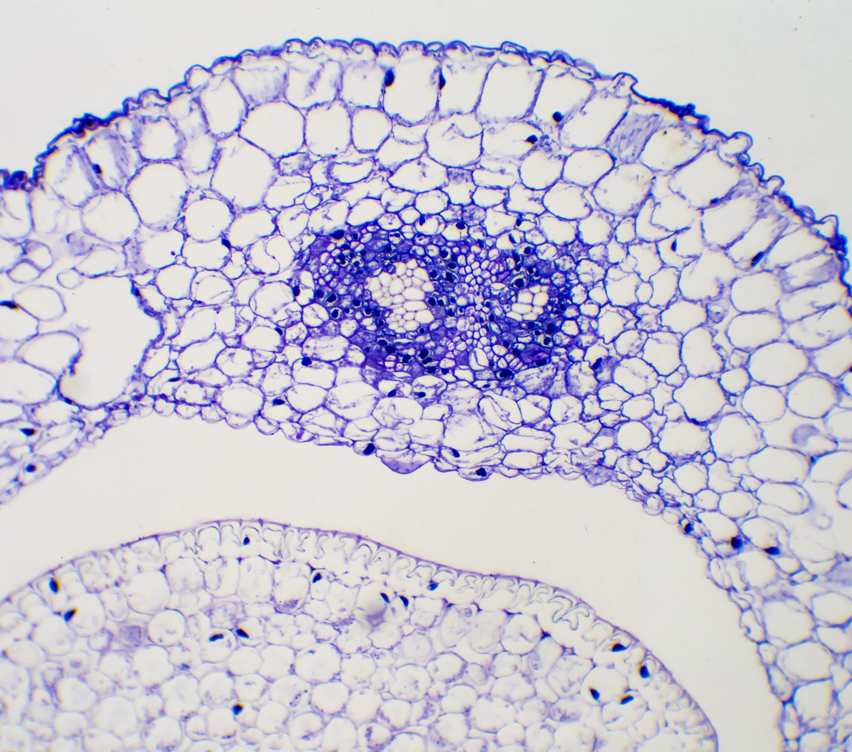
Strong negotiators are curious. Weak negotiators are agressive.

Slide 23
Ask why 3-5 times
Three times in a row, gently ask:
Why is that?
What are the reasons behind that for you?
Why is that the right way to do this for you?
This will take you deeper into the cause of the conflict.
Encourage the other party to think more deeply.
Why it works: This method helps to uncover hidden issues that may not be obvious at first glance and thus go beyond the surface level of conflict.

Slide 24
If it can't be negotiated, it can be mediated

Slide 25
Research shows that even in the event of a failed negotiation, mediation can help resolve the issue.

Slide 26
When not to go to court?
Speed of the resolution
Control over solution expenses
Maintaining long-term relationships with the other party
Control over the final solution
Private proceedings vs. public in court

Slide 27
Speed
Court proceedings:
269 days in the courts of first instance
978 in second instance proceedings
Arbitration: 7-9 months
Mediation: 1-9 hours

Slide 28
Mediation lasts for 3 hours. Courts last forever.

Slide 29
The speed of court vs. mediation

Slide 31
How much do the court proceedings cost?

Slide 32
Unpaid invoice 50.000 CZK
Total court | 26 600 CZK (or also 43 600 CZK)
Court fee | 2 500 CZK
Legal representation according to the lawyer's tariff - acceptance of representation - notice - legal analysis - motion for initiation of proceedings - participation in the court hearing | 24 100 CZK (without VAT)
(In case of loss, legal representation of the other party) | 17 000 CZK (without VAT)

Slide 33
Unpaid invoice 50.000 CZK
Total mediation | 4 000-12 000 CZK
Contractual remuneration of the mediator | 2 000-4 000 CZK / party
Legal representation | 2 000 CZK / hour

Slide 34
Unpaid invoice 500.000 CZK
Total court | 78 000 CZK (or 120 400 CZK)
Court fee | 25 000 CZK
Legal representation according to the lawyer's tariff - acceptance of representation - notice - legal analysis - motion for initiation of proceedings - participation in the court hearing | 53 000 (without VAT)
(In case of loss, legal representation of the other party) | 42 400 CZK (without VAT)

Slide 35
Unpaid invoice 500.000 CZK
Total mediation | 4 000-36 000 CZK
Contractual remuneration of the mediator | 2 000-4 000 CZK/hour/party
Legal representation | 2 000 CZK / hour

Slide 37
Mini Mediation
Assume your role (Alex/Sam/Kim)
Together find one or more solutions
Be creative
Make assumptions
Do not invent new facts
5 minutes

Slide 38
Questions?

Slide 39
Thank you for your attention!
www.consensus.cz
LI: www.linkedin.com/in/veronikaportes/
FB: www.facebook.com/consensus.cz
IG: mediatorka_veronika

