Slide 1
Europe Outlook: Brave New World March 2025
Kamil Kovar, Assc Director, Moody’s Analytics
April, 2025

Slide 2
Global Environemnt

Slide 3
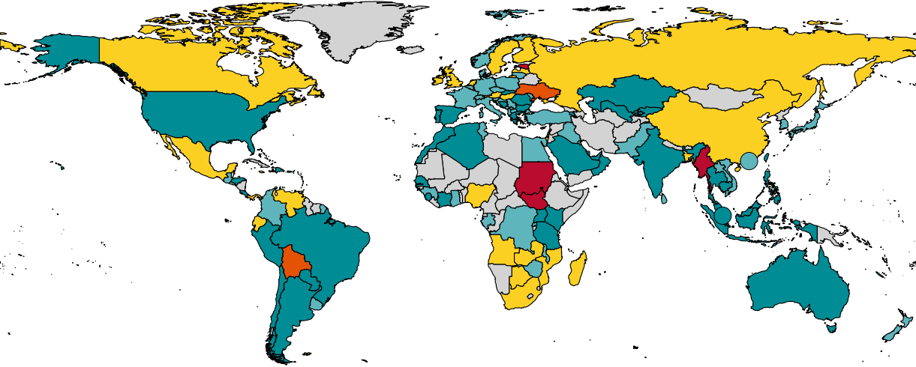
Probability of a Recession Starting in the Next 12 Months
Regional aggregates, weighted by real GDP at PPP
Europe 45%
North America 29%
Asia-Pacific 38%
MENA 30%
0% to 32%
33% to 49%
Sub-Saharan
Africa 48%
50% to 65%
66% to 100%
In Recession
South America 33%
Source: Moody’s Analytics

Slide 4
Trump’s Trade War Takes a Dark Turn
U.S. effective tariff rate, import duties as a % of U.S. imports
Effective tariff rate contribution, ppt
As of April 9th
Sources: Yale Budget Lab, Moody’s Analytics

Slide 5
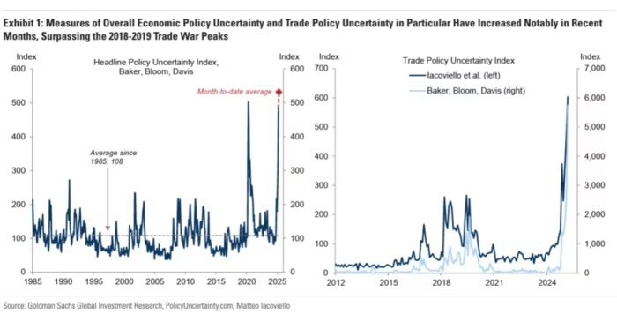
Effect: Dramatic Increase In Policy Uncertainty

Slide 6
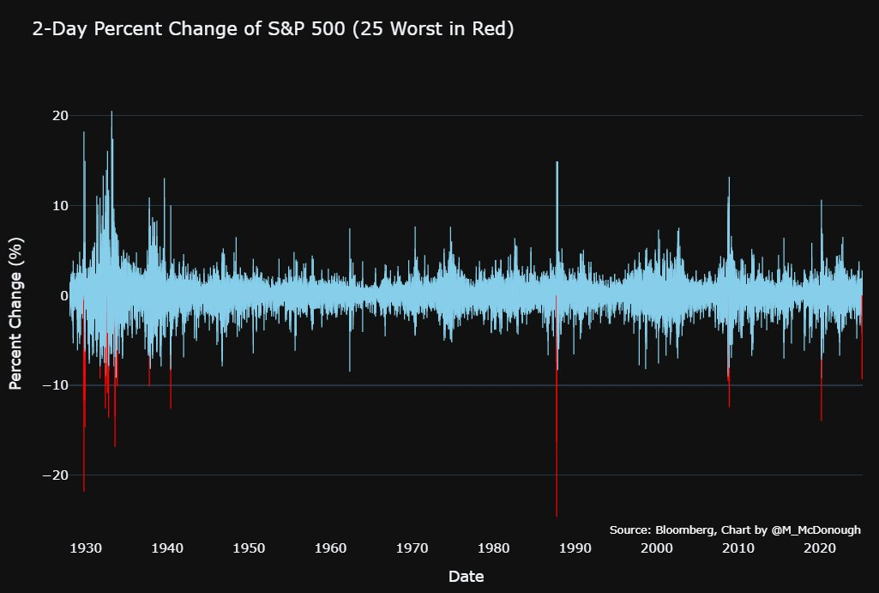
Market Reaction: Stock Markets Crash

Slide 7
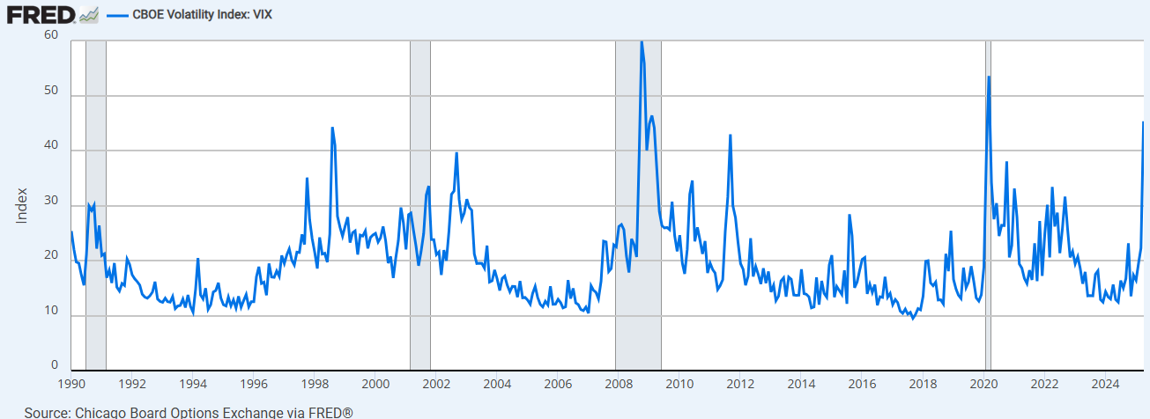
Market Reaction: Expected Volatility Jumped

Slide 8
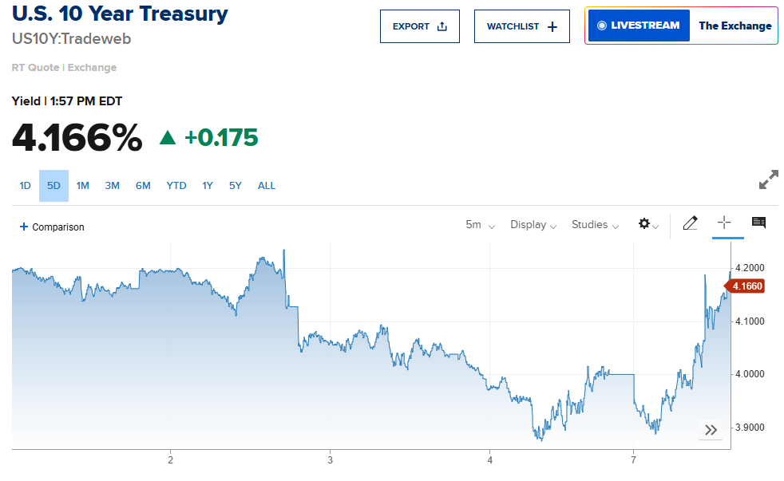
Market Reaction: U.S. Government Bond Yields Whipsawed

Slide 9
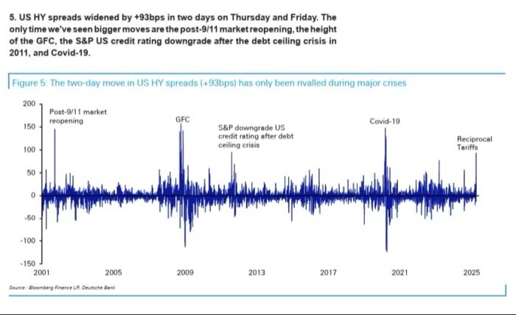
Market Reaction: Risky Bond Yields Jump

Slide 10
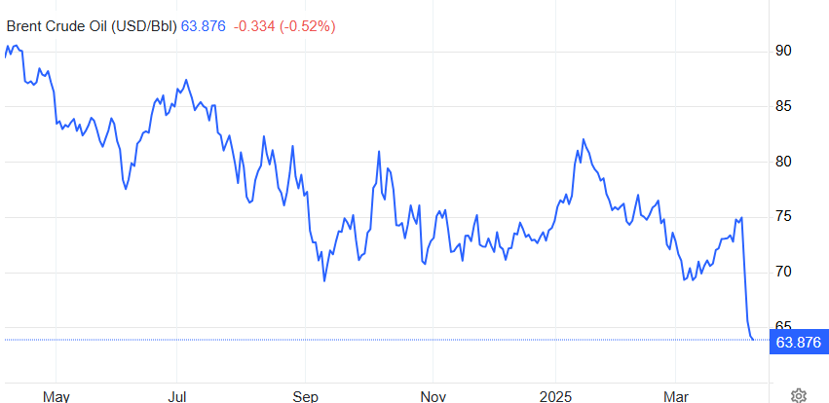
Market Reaction: Oil Prices Plunge

Slide 11
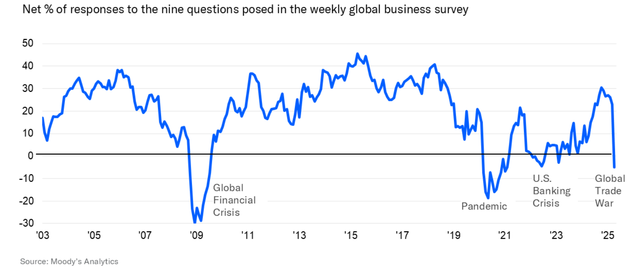
Main Street Reaction: Confidence Plunges

Slide 12
Europe Baseline

Slide 13
Substantial Hike in Tariffs Is Likely
U.S. Import duties, % of imports
Sources: U.S. Census Bureau, Moody’s Analytics

Slide 14
Gradual Steps Downwards For Output
Increase in GDP during 2025-2026, %; contributions to forecast revisions, p.p.
Sources: Moody’s Analytics

Slide 15
Exports And Investment Will Be Most Affected
% deviation between Nov and Dec baselines due to Trump election win; contributions, ppts
Sources: Moody’s Analytics

Slide 16
Some Countries Are More Exposed Than Others
Exports to U.S. as share of…
Impact of Trump presidency on GDP by end of 2026, ppts
Sources: COMTRADE, Moody’s Analytics

Slide 17
With Exports and Investment Even Weaker, Consumption Will Drive Growth
Euro zone GDP ex Ireland, % change qtr ago; contributions, ppts
Forecast
Sources: Eurostat, Moody’s Analytics
Two European Tales

Slide 18
Final Domestic Demand Is Gaining Strength…
Real final domestic demand, % change quarter-ago
Sources: Eurostat, Moody’s Analytics

Slide 19
…Across Components And Countries
Real private consumption % change quarter ago
Real fixed investment, % change quarter ago
Sources: Eurostat, Moody’s Analytics

Slide 20
Net Exports Are Declining For The Bad Reason
Euro zone ex Ireland, % change quarter ago; contributions, ppts
Sources: Eurostat, Moody’s Analytics

Slide 21
Inflation Is Now Expected To Drop Below Target
Euro zone HICP, % change yr ago; contributions, ppts
Forecast
Sources: Eurostat, Moody's’ Analytics

Slide 22
ECB Normalizes Goes Below Neutral, While Yields Jump Around
ECB deposit rate, %
10-Year bond yields, %
Sources: ECB, Moody’s Analytics
Two European Tales

Slide 23
Many Risks Everywhere

Slide 24
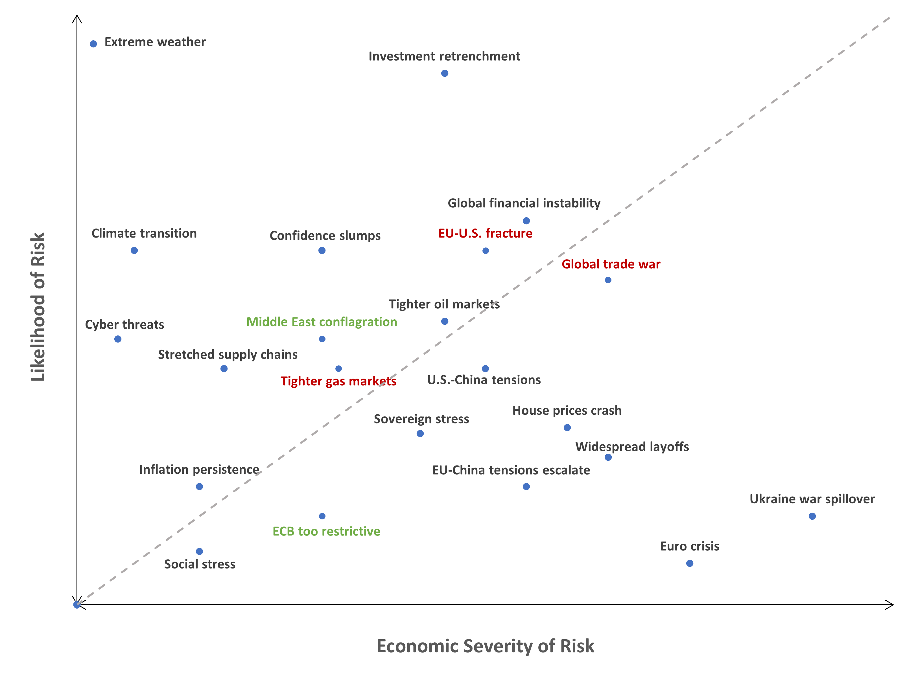
Risks Are Centered Around U.S. Policy
Source: Moody’s Analytics

Slide 25
Tariffs Could Escalate, And So Could The Impact On Economy
Effective tariff rate on EU exports to US, %
Shortfall in GDP relative to baseline over 3 years, %
Reciprocal tariff proposal
Sources: Moody’s Analytics

Slide 26
Baseline
Upside
Downside
Things Could Go Better – Or Much Worse
Tariffs
War in Ukraine
Defense spending
Average effective tariff rate is increased by more than 10%, with less than proportional retaliation from the EU, but there is no further tit-for-tat.
Conflict continues with varying intensity, as negotiations fail to lead to lasting peace. US aid is scaled down dramatically, while EU only partially compensates.
European defense spending increases, with mix of financing at national and EU level, including some repurposing of existing EU funds.
Tariff war avoided via mutually beneficial deal.
A peace deal of a lasting ceasefire is agreed, with return of some of Russian gas flows and some relaxation in sancitons.
European defense spending is ramped up with h significant share financed at the EU level.
Initial tariffs are set higher and further tit-for-tat escalation ensues, ultimately leading to tariffs increasing by 20-35%.
The war drags on, with Ukraine steadily losing ground as the U.S. cuts off its support. Fears grow that EU/NATO will be dragged into the conflict.
In face of opposition from electorates the EU states struggle to increase defense spending.

Slide 27
Manufactured Products Will Have To Bear The Brunt Of Retaliatory Tariffs
EU imports from US, 2023, € bil
Sources: Eurostat, Moody’s Analytics

Slide 28
Goods Trade Is Only Part Of The Story
EU-U.S. trade balance, bil eur
Sources: Eurostat, Moody's Analytics

Slide 29
What Is The Point Of All This?
Negotiating tactic
Rectifying the unfair trade imbalances caused by surplus countries’ savings in dollar assets (Miran thesis)
Lowering non-trade barriers
Obtaining concessions on political goals (immigration, geopolitical)
Extracting benefits at the expense of allies (e.g. resources)
Re-industrialization, rebalancing and fiscal revenue
Re-industrialization of American heartland
Eliminating “unfair” trade deficits
Replacing corporate and income taxes with tariffs
Changing the world order
Moving away from rules-based order towards big power politics and spheres of influence
Unshackling the US from self-imposed constraints in its sphere of influence (“America First”)
Ideological realignment
Notes:
Belgium
13.77%
Vlaams Belang
27-Oct-24
Flemish nationalist, eurosceptic, far-right
Bulgaria
12.92%
Revival
9-Jun-24
Far-right, ultranationalist, Russia-friendly
Czechia
9.56%
Freedom and Direct Democracy (SPD)
9-Oct-21
Next parliamentary election in 2025.
Denmark
2.63%
Danish People's Party
1-Nov-22
Germany
10.40%
Alternative for Germany (AfD)
26-Sep-21
Results from federal election in 2021, next one in 2025. However, state elections have been held in Germany since, with big wins for AfD in Brandenburg (29.2%), Thuringia (32.8% - coming first), and Saxony (30.6%).
Estonia
17.76%
Conservative People's Party
5-Mar-23
Anti-immigration, Euroscepticism
Greece
12.81%
Spartans (4.68%), Greek Solution (4.44%), Niki (Victory) (3.69%)
25-Jun-23
Three far-right parties in parliament, replacing Golden Dawn
Spain
12.40%
Vox
23-Jul-23
France
33.21%
National Rally (RN)
30-Jun-24
First-round results, legislative election in 2024
Croatia
9.56%
Homeland
17-Apr-24
Italy
25.99%
Brothers of Italy
25-Sep-22
In coalition, the share rises to roughly 44%
Latvia
9.40%
National Alliance
1-Oct-22
Lithuania
21.72%
Dawn of Nemunas (14.97%), EAPL-CFA (3.88%), National Alliance (2.87%)
27-Oct-24
Hungary
58.23%
Fidesz (52.52), Our Homeland (5.71%)
3-Apr-22
Netherlands
25.72%
PVV (23.49%), FvD (2.23%)
22-Nov-23
General election; PVV is Geert Wilders
Austria
28.80%
Freedom Party of Austria (FPO)
29-Sep-24
Best result in party history
Poland
42.60%
Law and Justice (PiS, 35.4%), Confederation (alliance, 7.2%)
15-Oct-23
The Confederation alliance is made up of RN/NN, RN is ultranationalist, far-right
Portugal
18.10%
Chega
10-Mar-24
Surge for Chega, quadrupling its previous seat count
Romania
9.08%
AUR
6-Dec-20
Next parliamentary election on 1 December 2024.
Slovenia
1.49%
Slovenian National Party
24-Apr-22
Extra-parliamentary party
Slovakia
5.60%
Slovak National Party (SNS)
30-Sep-23
Neo-nazi 'Our Slovakia' dropped out of parliament in 2023. SNS is closest to far-right
Finland
20.10%
Finns Party
2-Apr-23
Extra-parliamentary far-right parties include: Power Belongs to the People and Freedom Alliance
Sweden
20.50%
Sweden Democrats (SD)
11-Sep-22
the Sweden Democrats became the second-largest party in the Riksdag; ideology has moderated
Norway
11.70%
Progress (FrP)
13-Sep-21
Some call Progress far-right, but this has been disputed.
Switzerland
27.93%
Swiss People's Party (UDC)
22-Oct-23
United Kingdom
14.30%
Reform UK
4-Jul-24
Bosnia and Herzegovina
16.34%
SNSD
2-Oct-22
Montenegro
1.20%
True Montenegro
11-Jun-23
Serbia
4.33%
Serbian Radical Party (1.5%), National Gathering coalition (Serbian Oathkeepers and Dveri, 2.83%)
17-Dec-23

Slide 30
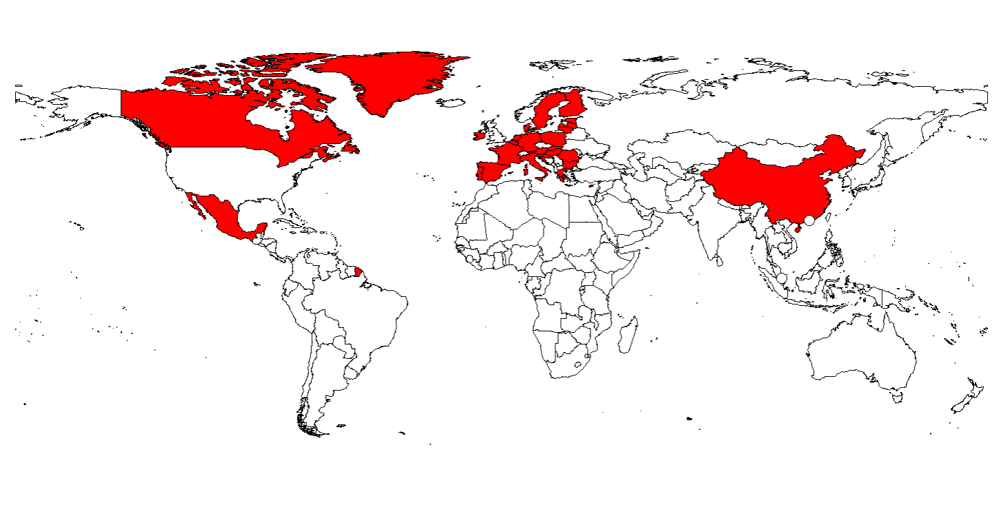
Is Multilateralism The Actual Target?
Multilateral organizations and agreements under Trump’s attack
Tariffs Fall More On Allies Than Adversaries And Nonaligned
WTO
Paris agreement
OECD global tax agreement
ICC
WHO
NATO
UN
Notes:
Belgium
13.77%
Vlaams Belang
27-Oct-24
Flemish nationalist, eurosceptic, far-right
Bulgaria
12.92%
Revival
9-Jun-24
Far-right, ultranationalist, Russia-friendly
Czechia
9.56%
Freedom and Direct Democracy (SPD)
9-Oct-21
Next parliamentary election in 2025.
Denmark
2.63%
Danish People's Party
1-Nov-22
Germany
10.40%
Alternative for Germany (AfD)
26-Sep-21
Results from federal election in 2021, next one in 2025. However, state elections have been held in Germany since, with big wins for AfD in Brandenburg (29.2%), Thuringia (32.8% - coming first), and Saxony (30.6%).
Estonia
17.76%
Conservative People's Party
5-Mar-23
Anti-immigration, Euroscepticism
Greece
12.81%
Spartans (4.68%), Greek Solution (4.44%), Niki (Victory) (3.69%)
25-Jun-23
Three far-right parties in parliament, replacing Golden Dawn
Spain
12.40%
Vox
23-Jul-23
France
33.21%
National Rally (RN)
30-Jun-24
First-round results, legislative election in 2024
Croatia
9.56%
Homeland
17-Apr-24
Italy
25.99%
Brothers of Italy
25-Sep-22
In coalition, the share rises to roughly 44%
Latvia
9.40%
National Alliance
1-Oct-22
Lithuania
21.72%
Dawn of Nemunas (14.97%), EAPL-CFA (3.88%), National Alliance (2.87%)
27-Oct-24
Hungary
58.23%
Fidesz (52.52), Our Homeland (5.71%)
3-Apr-22
Netherlands
25.72%
PVV (23.49%), FvD (2.23%)
22-Nov-23
General election; PVV is Geert Wilders
Austria
28.80%
Freedom Party of Austria (FPO)
29-Sep-24
Best result in party history
Poland
42.60%
Law and Justice (PiS, 35.4%), Confederation (alliance, 7.2%)
15-Oct-23
The Confederation alliance is made up of RN/NN, RN is ultranationalist, far-right
Portugal
18.10%
Chega
10-Mar-24
Surge for Chega, quadrupling its previous seat count
Romania
9.08%
AUR
6-Dec-20
Next parliamentary election on 1 December 2024.
Slovenia
1.49%
Slovenian National Party
24-Apr-22
Extra-parliamentary party
Slovakia
5.60%
Slovak National Party (SNS)
30-Sep-23
Neo-nazi 'Our Slovakia' dropped out of parliament in 2023. SNS is closest to far-right
Finland
20.10%
Finns Party
2-Apr-23
Extra-parliamentary far-right parties include: Power Belongs to the People and Freedom Alliance
Sweden
20.50%
Sweden Democrats (SD)
11-Sep-22
the Sweden Democrats became the second-largest party in the Riksdag; ideology has moderated
Norway
11.70%
Progress (FrP)
13-Sep-21
Some call Progress far-right, but this has been disputed.
Switzerland
27.93%
Swiss People's Party (UDC)
22-Oct-23
United Kingdom
14.30%
Reform UK
4-Jul-24
Bosnia and Herzegovina
16.34%
SNSD
2-Oct-22
Montenegro
1.20%
True Montenegro
11-Jun-23
Serbia
4.33%
Serbian Radical Party (1.5%), National Gathering coalition (Serbian Oathkeepers and Dveri, 2.83%)
17-Dec-23

Slide 31
(German) Deindustrialization, And Second Engine Is Not Picking Up The Slack
Industrial production, Index, 2015M01=100
Gross value added in IT sector, Index, 2019q1=100
Number of Unicorns, 2024
Pandemic
drop
Sources: EU Commission, World Population Review, Moody’s Analytics

Slide 32
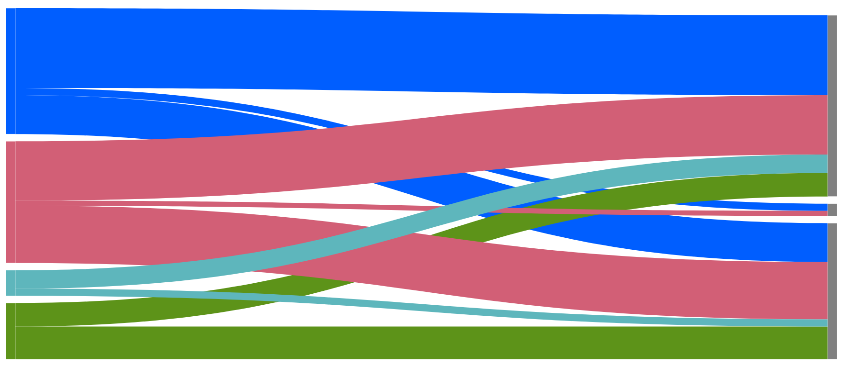
Eroding Competitiveness And Car Wars
EV imports to Europe by country of production and manufacturer headquarters, thousand vehicles
Number of Manufacturing projects by source (L) and destination (R), 2019-2024
China
S. Korea
US
Europe
Europe
Asia
China
Other
USA
North America
Sources: IEA, Orbis Cross border Investment Database, Moody’s Analytics

Slide 33
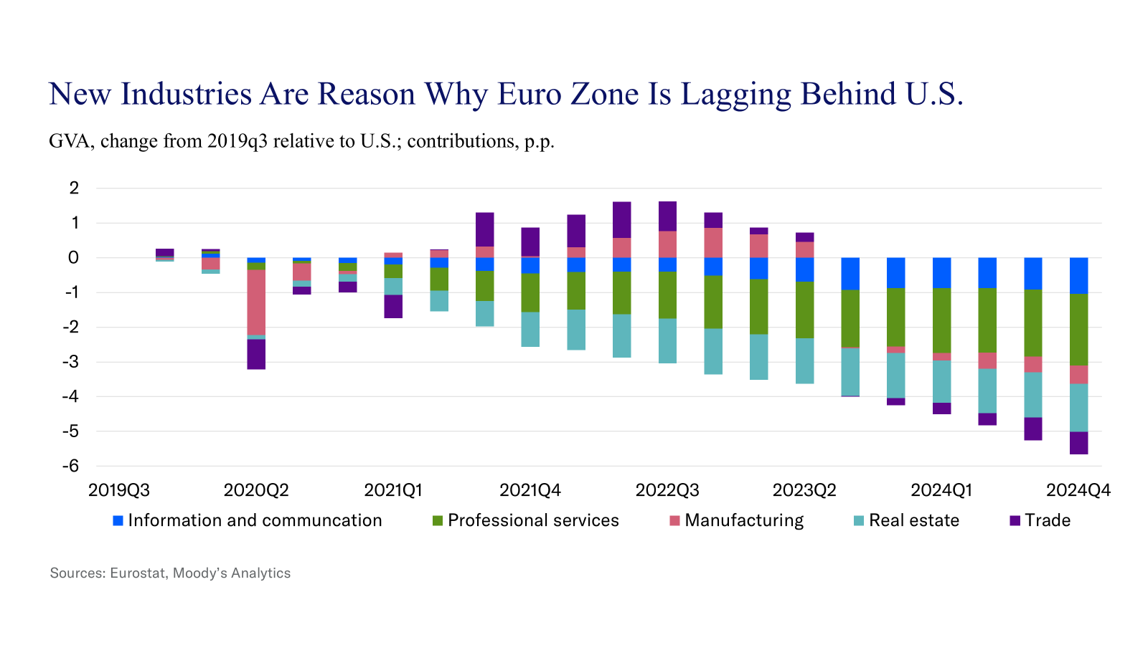
Structural Improvements In South Win Over Cyclical Worsening In North
Unemployment rate, Contribution to deviation from December 2023, percentage points
Sources: Eurostat, Moody’s Analytics

Slide 34
Defence Spending Might Provide An Upside For European Growth
Military spending, % of GDP
Sources: NATO, Moody’s Analytics

Slide 35
Inflation Offset Pandemic, But What Will Offset Defense?
Change government debt-to-GDP ration, p.p.
Sources: Eurostat, Moody’s Analytics

Slide 36
Euroscepticism Puts Limits On Possible Upsides
Share of far-right vote in most recent legislative elections, %
Sources: Moody’s Analytics
Notes:
Belgium
13.77%
Vlaams Belang
27-Oct-24
Flemish nationalist, eurosceptic, far-right
Bulgaria
12.92%
Revival
9-Jun-24
Far-right, ultranationalist, Russia-friendly
Czechia
9.56%
Freedom and Direct Democracy (SPD)
9-Oct-21
Next parliamentary election in 2025.
Denmark
2.63%
Danish People's Party
1-Nov-22
Germany
10.40%
Alternative for Germany (AfD)
26-Sep-21
Results from federal election in 2021, next one in 2025. However, state elections have been held in Germany since, with big wins for AfD in Brandenburg (29.2%), Thuringia (32.8% - coming first), and Saxony (30.6%).
Estonia
17.76%
Conservative People's Party
5-Mar-23
Anti-immigration, Euroscepticism
Greece
12.81%
Spartans (4.68%), Greek Solution (4.44%), Niki (Victory) (3.69%)
25-Jun-23
Three far-right parties in parliament, replacing Golden Dawn
Spain
12.40%
Vox
23-Jul-23
France
33.21%
National Rally (RN)
30-Jun-24
First-round results, legislative election in 2024
Croatia
9.56%
Homeland
17-Apr-24
Italy
25.99%
Brothers of Italy
25-Sep-22
In coalition, the share rises to roughly 44%
Latvia
9.40%
National Alliance
1-Oct-22
Lithuania
21.72%
Dawn of Nemunas (14.97%), EAPL-CFA (3.88%), National Alliance (2.87%)
27-Oct-24
Hungary
58.23%
Fidesz (52.52), Our Homeland (5.71%)
3-Apr-22
Netherlands
25.72%
PVV (23.49%), FvD (2.23%)
22-Nov-23
General election; PVV is Geert Wilders
Austria
28.80%
Freedom Party of Austria (FPO)
29-Sep-24
Best result in party history
Poland
42.60%
Law and Justice (PiS, 35.4%), Confederation (alliance, 7.2%)
15-Oct-23
The Confederation alliance is made up of RN/NN, RN is ultranationalist, far-right
Portugal
18.10%
Chega
10-Mar-24
Surge for Chega, quadrupling its previous seat count
Romania
9.08%
AUR
6-Dec-20
Next parliamentary election on 1 December 2024.
Slovenia
1.49%
Slovenian National Party
24-Apr-22
Extra-parliamentary party
Slovakia
5.60%
Slovak National Party (SNS)
30-Sep-23
Neo-nazi 'Our Slovakia' dropped out of parliament in 2023. SNS is closest to far-right
Finland
20.10%
Finns Party
2-Apr-23
Extra-parliamentary far-right parties include: Power Belongs to the People and Freedom Alliance
Sweden
20.50%
Sweden Democrats (SD)
11-Sep-22
the Sweden Democrats became the second-largest party in the Riksdag; ideology has moderated
Norway
11.70%
Progress (FrP)
13-Sep-21
Some call Progress far-right, but this has been disputed.
Switzerland
27.93%
Swiss People's Party (UDC)
22-Oct-23
United Kingdom
14.30%
Reform UK
4-Jul-24
Bosnia and Herzegovina
16.34%
SNSD
2-Oct-22
Montenegro
1.20%
True Montenegro
11-Jun-23
Serbia
4.33%
Serbian Radical Party (1.5%), National Gathering coalition (Serbian Oathkeepers and Dveri, 2.83%)
17-Dec-23

Slide 37
Limited Upside For Russian Gas Flows
Dutch natural gas TTF, € per MWh, 1-mo forward contract
Imports of gas to EU, bcms
Sources: ICE, Moody’s Analytics

Slide 38
Thank you
Contact Us
Email helpeconomy@moodys.com
U.S./Canada +1.866.275.3266
EMEA +44.20.7772.5454 (London)
+420.234.747.505 (Prague)
Asia/Pacific +852.3551.3077
All Others +1.610.235.5299
www.economy.com

