Slide 1
History of Economic Thought Week 5 - Seminar Development of Ideas on International Trade Tomáš Cahlík

Slide 2
Outline
Discussion of Readings
Contemporary Context
Balance of Payment
Absolute and Comparative Advantage
Political Economy of Foreign Trade
European Integration
Ideas on International Trade in Historical Perspective

Slide 3
Discussion of Readings
Adam Smith: The Wealth of Nations, Book 1 Chapters 1-4
Division of labour is the most important factor in improving the productive powers of labour.
AS uses comparisons – e.g. compares the production of corn in England, France and Poland.
Invention of a great number of machines is the effect of the division of labour.
In a well-governed society universal opulence extends itself to the lowest ranks of the people.

Slide 4
Discussion of Readings
Adam Smith: The Wealth of Nations, Book 1 Chapters 1-4
Division of labour is originally effect of some propensity to exchange, not effect of wisdom.
We cannot expect our dinner from the benevolence of the butcher.
The differences in different men are mostly effects of habit, custom and education.
A philosopher is by nature in genius and disposition not very different from a street porter.

Slide 5
Discussion of Readings
Adam Smith: The Wealth of Nations, Book 1 Chapters 1-4
The extent of the market has an impact on the division of labour.
AS illustrates the advantage of the water-carriage on the example of transport between London and Edingurgh.
The on-the-see areas have a better position for development than the inland areas.
Metal and other goods have been used for facilitating exchanges
Use value x value in exchange

Slide 6
Discussion of Readings
John Stuart Mill: Principles of political Economy, Book V (On the influence of government), Chapters V, VI
It is an excellent maxim to make present resources suffice for present wants.
The basic way of extinguishing or reducing a national debt, is by means of a surplus revenue.
Any casual gain, or god-sent gain of the nation, is naturally devoted to reducing a national debt.
There are cases in which it is not desirable to maintain a surplus revenue for the redemption of Debt.

Slide 7
Discussion of Readings
John Stuart Mill: Principles of political Economy, Book V (On the influence of government), Chapters V, VI
The doctrine of Protection to Native Industry is false.
The doctrine of Protection to Native Industry is supported by pleas of national subsistence and defense.
Protecting duties can be temporarily used for naturalizing a foreign industry.
Criticism of the policy compelling colonies to trade exclusively with the dominant country.
Broad use of statistical data for supporting his analyses.

Slide 8
Balance of Payment
Current Account
Trade balance
..
Financial Account
Capital Account
Trade Balance - different balancing processes, e.g.
Trade surpluss -> Increase of supply of foregin currencies on the foreign exchange market -> Appreciation of domestic currency -> Export becomes more expensive -> Trade balance balances

Slide 9
Comparative Advantage
We have 2 countries, X and Y and two products, A and B. Following table is about how many days each country needs for production of 1 unit of product A or B.
Following table is about monthly productivities, we assume 24 days per month. Country X has higher productivity for both products, we say it has absolute advantage.
 | Product A | Product B
Country X | 1 day | 1 day
Country Y | 2 days | 4 days
 | Product A | Product B
Country X | 24 units | 24 units
Country Y | 12 units | 6 units

Slide 10
Comparative Advantage
Opportunity costs: value of the second best option we cannot do to be able to do the best option.
Country X: Opportunity costs for production of 1 unit of A are 1 unit of B. Opportunity costs for production of 1 unit of B are 1 unit of A.
Country Y: Opportunity costs for production of 1 unit of A is 1/2 unit of B. Opportunity costs for production of 1 unit of B are 2 units of A.
 | Product A | Product B
Country X | 1 unit B | 1 unit A
Country Y | ½ unit B | 2 units A

Slide 11
Comparative Advantage
Country Y has lower opportunity costs for product A, we say that it has comparative advantage in production of product A.
Country X has lower opportunity costs for product B, we say that it has comparative advantage in production of product B.
If countries open to foreign trade and specialize in products where they have comparative advantage, the system of two countries as a whole can gain
 | Product A | Product B
Country X | 1 unit B | 1 unit A
Country Y | ½ unit B | 2 units A

Slide 12
Comparative Advantage
Following table shows monthly consumption before opening to foreign trade. Both countries are on their Production Possibilities Frontier.
Following table shows potential monthly production after opening to foreign trade and specialization
Country X exports 1 unit of B to country Y, country Y exports 1 unit of A to country X. Consumption will be on the same level but 1 more unit of A can be produced.
 | Product A | Product B
Country X | 4 units | 20 units
Country Y | 6 units | 3 units
 | Product A | Product B
Country X | 3 units | 21 units
Country Y | 8 units | 2 units

Slide 13
Political Economy of Foreign Trade
Economists in general agree that free trade is beneficial for all countries
Domestic population is very often for protectionism and governments very often create barriers for trade
Political Economy of Foreign Trade explains why.

Slide 14
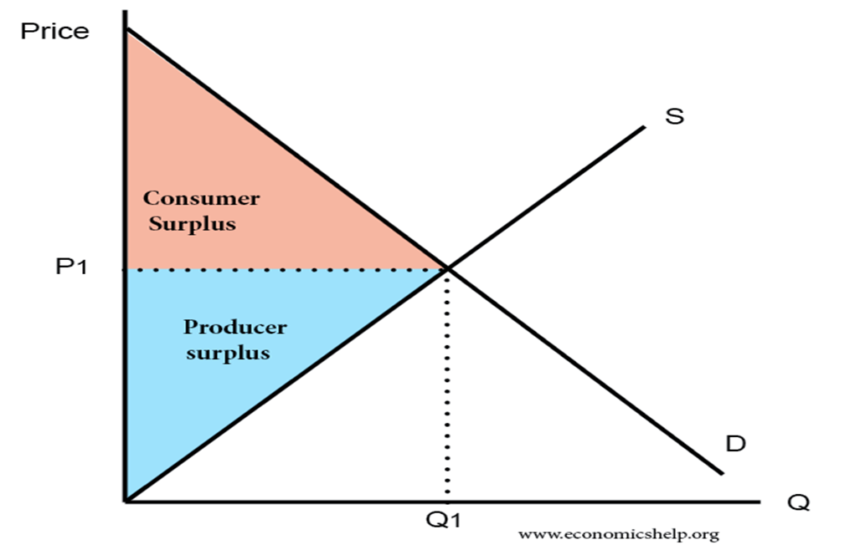
Political Economy of Foreign Trade
Assume following situation on some domestic market before opening to trade:

Slide 15
Political Economy of Foreign Trade
Assume that after opening import is possible in any amount for a lower price. Consumer surplus and Total surplus increase but Producer surplus decreases.
P world

Slide 16
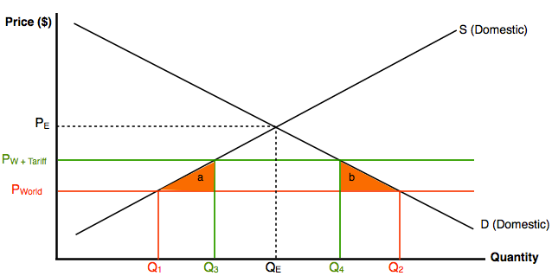
Political Economy of Foreign Trade
Producers tries to persuade government to implement an import tariff. It increases producer surplus, decreases Consumer surplus, government has an income from tariff and Total surplus decreases by triangles a and b, in comparison with the situation without tariff. a and b is called the deadweight loss from tariff.

Slide 17
Political Economy of Foreign Trade
Theoretical analysis shows that opening to trade maximises social welfare.
Empirical analysis as well, both on the level of global economy and on countries´ level.
WTO (World Trade Organization) tries to decrease trade barriers.
Trade war damages consumers in all fighting countries.

Slide 18
European Integration
Integration Stages:
Sectoral integration
Free Trade Area
Customs Union
Common Market
Integration of Economic Policies
Political Integration

Slide 19
Ideas on International Trade in Historical Perspective
Plato: City state is not entirely self-sufficient. The needs of both the body and the soul could be satisfied by international exchange
Confucius: „Wise kings inspected travelers at custom-houses but did not levy duty upon commodities.“
European Middle Ages: „providentialist theory of trade“
By scattering resources to different parts of the world, God created incentives for people to interact with each other

Slide 20
Ideas on International Trade in Historical Perspective
Francisco de Vitoria (Salamanca school)
International trade is based on natural law
Hugo Grotius
„The Law of War and Peace“ (1625)
No state should deny any other state the opportunity to trade
Thomas Mun (Mercantilist)
„England´s Treasure by Forraign Trade“ (1664)
Recommendation of policies for positive balance of trade to generate net inflow of species (gold and silver)
He understands the impact it has on domestic price level

Slide 21
Ideas on International Trade in Historical Perspective
David Hume
„Essays, Moral, Political, and Literaly“ (1742)
The price – specie flow model
Application of the Quantity Theory of Money to international trade
Description of the balancing proces of the trade balance – in fact almost the same as is tought today

Slide 22
Ideas on International Trade in Historical Perspective
Adam Smith
Trade is beneficial in general
Fierce supporter of free international trade
Description of Absolute advantage
„Agriculture is the proper business of all new colonies; a busines which the cheapness of land renders more advantageous than any other.“
Importance of transportation costs in determining both the volume and composition of trade
Gains from trade:
More abundant goods and greater variety
Lower costs abroad
Widening of market allows for further specialization and gains in productivity

Slide 23
Ideas on International Trade in Historical Perspective
David Ricardo
Description of Comparative advantage
Simplifying assumptions
Portugal and England, Wine and Cloth
Labour is the only relevant factor of production
In both countries and both industries is perfect competition
Factor of production can freely move domestically but cannot move between the two countries
There are no barriers to trade, such as tariffs or quotas

Slide 24
Ideas on International Trade in Historical Perspective
John Stuart Mill
1844 „The Unsettled Questions of Political Economy“
For which prices will coutries trade?
Description in a simple model of two countries and two commodities, countries realize all their surplusses: “The produce of a country exchanges for the produce of the other country at such values as are required in order that the whole of her exports may exactly pay for the whole of her imports.”
Touches the concept „Terms of Trade“
Terms of Trade = Export Price Index/Import Price Index

Slide 25
Ideas on International Trade in Historical Perspective
John Stuart Mill
Three distinct gains from trade:
Direct effects
Possibility to get products with lower costs
Indirect effects
Larger market increases productivity
Intellectual and moral effects
Exposition to different cultures

Slide 26
Ideas on International Trade in Historical Perspective
Heckscher-Ohlin model:
What do differences in comparative costs (Ricardian model) depend on? They depend on differences in the abundance of factors of production and on the intensity different commodities are produced with those factors.
Bertin Ohlin (1899 – 1979), Nobel price in Economics in 1977 (with James Meade)
Eli Heckscher (1879 – 1952)
„The Effect of Foreign Trade on the Distribution of income“ (1919)

Slide 27
Ideas on International Trade in Historical Perspective
Wolfgang Stolper (1912 – 2002)
Paul Samuelson (1915 – 2009), Nobel Price in Economics 1970
Stolper-Samuelson Theorem (1941)
It shows, e.g., that if international price of a capital intensive good increases the return to capital increases while the return to labor decreases.
It shows the possibility of distributional conflicts over international trade policy – link to the „Political economy of international trade“.

Slide 28
Ideas on International Trade in Historical Perspective
Paul Krugman (1953 - ), Nobel Price in Economics in 2008
„New trade theory“
It focuses on the explanation of intra-industry trade
Trade in similar products
It stresses the importance of increasing returns to scale
Previous trade models were based on perfect competition, this one is based on the monopolistic competition model
Avinash Dixit, Joseph Stiglitz: "Monopolistic Competition and Optimum Product Diversity", 1977
Joseph Stiglitz, Nobel Price in Economics in 2001

