Slide 1
Ethics and Economics Week 3 Utilitarianism and Justice Tomáš Cahlík

Slide 2
Outline
Empiricist Ethics
Empiricism
Hedonism
David Hume
Utilitarianism
Jeremy Bentham
John Stuart Mill
Utilitarianism in Economics after the Marginalist Revolution

Slide 3
Empiricist Ethics – Empiricism
Empiricist Enlightenment in 17th and 18th century in the UK started the philosophical tradition that has continued to have influence until nowadays.
Basic features:
The only source of knowledge is empirical (sensual) experience (empiricism x rationalism). Related to the development of sciences and social sciences
Stress on individual liberty

Slide 4
Empiricist Ethics – Hedonism
Hedonism: human activities are determined by the desire of getting pleasure and avoiding pain
Moraly good is what brings pleasure, moraly bad is what brings pain.
Reason serves to calculate pleasures and pain, as
a technical tool: how can we fulfil the desired aim
a pragmatic tool: which are the desired aims?
Ethics is art of living
Hedonism exists since ancient times
Aristippos of Cyrene (435 – 365)
Epicuros (341 – 270)
Egoistic orientation of both

Slide 5
Empiricist Ethics – David Hume
David Hume (1711 – 1776) created on an empiricist basis an ethical theory with social dimension
Book: A Treatise of Human Nature: Being an Attempt to Introduce the Experimental Method of Reasoning into Moral Subjects (1739–40)
Hume analysis „personal merits“ (values) and finds that people most value (have positive affects toward) merits that are not egoistic but altruistic and socially related.
„Extensive sympathy“, undestood here as empathy into affects of other people, serves as communication channel for the evaluation of affects and helps to create non-egoistic „steady and general points of view“ .
In this process, „moral sentiment“ is created that is shared in the society. Translated into the modern language: A shared morality – commonly accepted rules – has been created in the society

Slide 6
Empiricist Ethics – David Hume
Hume´s ethics is based on moral sentiments, not on reason. Reason just serves as a technical and pragmatic tool.
Following our moral sentiments increases our pleassure and decreases our „pain“. Our egoism brings social benefits, because moral sentiments are shared in the society .
We can realize that it is pragmatic to follow our moral sentiments, our interests are better served in social cooperation than in confrontation.
There is a time inconsistency in our behaviour; we have a tendency to break the norms if it is in our interest

Slide 7
Empiricist Ethics – Adam Smith
Adam Smith (1723 – 1790)
Close friend of David Hume
Basic Works:
The Theory of Moral Sentiments (1759)
Lectures on Justice, Police, Revenue and Arms (1763)
The Wealth of Nations (1776)
Essays on Philosophical Subjects (1795)
Following commonly accepted rules works well, except of extreme situations. In extreme situations we must behave reasonably (in the Thomas Aquinas sense).

Slide 8
Bentham´s Utilitarianism
Jeremy Bentham (1748 – 1832)
The highest principle of morality (what ought to be) is to maximize utility (= intensity and duration of pleasure – intensity and duration of pain) for the maximum number of people.
Consequentialist reasoning – intentions are not important for the evaluation of actions
All human behaviour (what we want) is determined by following the maximization of utility
His motivation was to build politics on scientific grounds
Book: „The Introduction to the Principles of Morals and Legislation“ (1780) – contains among others the design of institutions
Features of Bentham´s Utilitarianism (what is):
Utility maximization has a natural biological basis; following self-interest is an inherent feature of human psychology
Utility is quantifiable
Interpersonal comparisons are possible – we have the same psychology

Slide 9
Bentham´s Utilitarianism
Measurement of Utility:
Bentham introduces a special unit for utility measurement, one util. Number of utils depends on:
Intensity of peasure (pain)
Duration of pleasure (pain)
Probability of pleasure (pain)
Remoteness of pleasure (pain)
In other words, he believes in cardinal utility. Later development in economics has led to abandoning cardinal utility and shift to ordinal utility.
Interpersonal Comparisons
Further development in economics has found this to be problematic, economists of the Austrian school deny it absolutely.

Slide 10
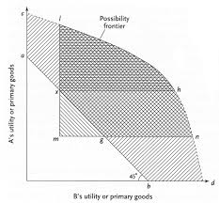
Bentham´s Utilitarianism
Why do we need government?

Slide 11
Bentham´s Utilitarianism
Explanation of previous diagram:
Line c-d is utility possibility frontier
Let us start on a point on the line a – b, e.g. y. We can increase utility of both if we redistribute primary goods in such a way that we will end in a point to the North-East of y. Such points can be attained through voluntary exchanges.
We can increase the total utility if we redistribute primary goods in such a way that we will end in a point above the line a – b. Not all such points can be attained through voluntary exchanges, some can be attained only through governmental redistribution.
We will use the small triangl below the a – b line later when we will discuss the theory of John Rawls.

Slide 12
Bentham´s Utilitarianism
Jeremy Bentham (1748 – 1832
According to Bentham´s highest principle of morality, which policy will be scientifically chosen?
 | Status Quo | Policy 1 | Policy II | Policy III | Policy IV | Policy V
Person A | 6 (utils) | 1000 | 8 | 10 | 16 | 8
Person B | 6 | 1 | 7 | 9 | 1 | 7
Person C | 6 | 1 | 4 | 0 | 1 | 3

Slide 13
Bentham´s Utilitarianism
J. Bentham: „The Principles of the Civil Code“ (1843)
State redistributes to the point of „practical equality“, not „absolute equality“, he realizes that redistribution destroys incentives to work, we call this argument today the „equity – efficiency trade – off“.
Relation between individual and state: Labor creates utility, law preserves it

Slide 14
Mill´s Utilitarianism
John Stuart Mill (1806 – 1873)
1848 : The Principles of Political Economy: with some of their applications to social philosophy
1859: On Liberty
Harm Principle
Freedom of speach as the path to the truth
Argumentation, not deliberation
Educate indifiduals to find right answers for a right reason
All knowledge is corrigible
From Verification to Falsification
Truth is a by-product of free exchange of ideas
Maximization of Utility (Market efficiency) is a by-product of free exchange of goods
1863: Utilitarianism
Distinction between higher and lower pleasures
Respecting rights maximizes utility in the long run

Slide 15
Utilitarianism
Continuing discussion on utilitarianism:
Utilitarian reasoning x Deontological reasoning: Plato (dialog Phaedo) – utilitarian reasoning cannot explain Socrates´s behaviour in the jail
Problem of distributive justice: redistribution x individual freedom
Problem of prediction (problem of cost-benefit analysis)
Utilitarism of single action x utilitarism of rules (norms)
Authenticity of life (You can be happy in a virtual world, but does the life in the virtual world make sense?)
Robert Nozick (1938 – 2002)
Book „Anarchy, State and Utopia“ 1974
Thought experiment with the „Experience Machine“

Slide 16
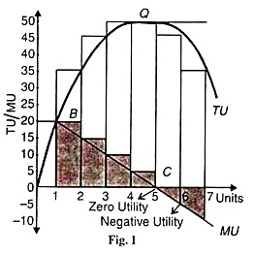
Utilitarianism in Economics after the Marginalist Revolution
Marginalism: Marginalist revolution in 1870ies
The Law of Diminishing Marginal Utility
What is the link between money and utils?

Slide 17
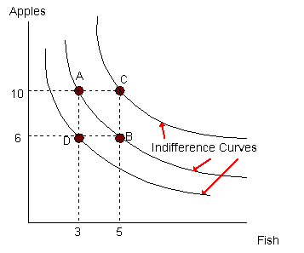
Utilitarianism in Economics after the Marginalist Revolution
From Cardinal Utility to Ordinal Utility
Indifference Curves

Slide 18
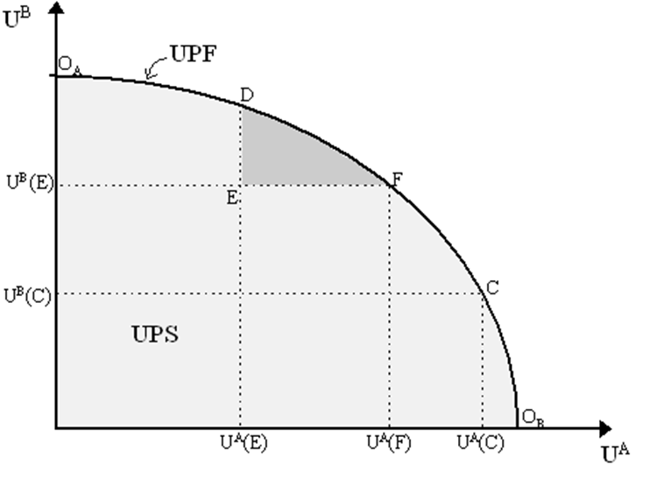
Utilitarianism in Economics after the Marginalist Revolution
Utility Possibility Frontier and Pareto Efficiency
Utilities of two individuals A and B are on axes
Points on the UPF are Pareto Efficient – we cannot make anyone better off without making anyone worse off.

Slide 19
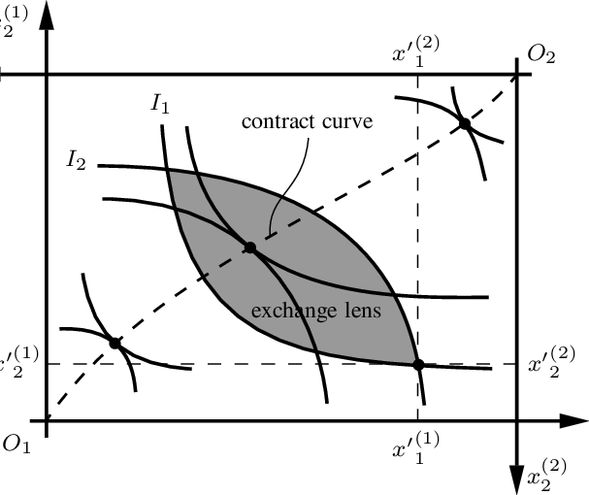
Utilitarianism in Economics after the Marginalist Revolution
Edgeworth box: mirrored immage of indifference curves for two individuals

Slide 20
Utilitarianism in Economics after the Marginalist Revolution
Link between the contract curve and the UPF

Slide 21
Utilitarianism in Economics after the Marginalist Revolution
Can we get the utility function for an individual?
Revealed Preference Theory: Defining utility function by observing individual behaviour
If yes, can we compare utility functions between individuals?

Slide 22
Utilitarianism in Economics after the Marginalist Revolution
Marginal Utility and Consumer Surpluss
Under what condition woud taxes increase social welfare?

