Slide 1
History of Economic Thought Week 6 Neoclassical Thought in the Anglosaxonian World and its Neighbourhood before Keynes. Tomáš Cahlík

Slide 2
Outline
Introduction
British Thought
Phillip Henry Wicksteed (1844 – 1927)
Francis Ysidro Edgeworth (1845 – 1926)
Alfred Marshall (1842 – 1924)
Arthur Cecil Pigou (1877 – 1959)
Lionel Robbins (1898 – 1984)
American Thought
John Bates Clark (1847 – 1938)
Irving Fisher (1867 – 1947)
Swedish School
Knut Wicksell (1851 – 1926)
The Theory of Market Forms
Antoine Augustin Cournot (1801 – 1877)
John Harold Clapham 1873 – 1946)
Piero Sraffa (1898 – 1983)
Edward Chamberlin (1899 – 1967)
Joan Robinson (1903 – 1987)

Slide 3
Introduction
Historical Background
The Belle Époque
Industrialization of many countries
Large firms
Gold Standard
Colonial Expansion
The Great War
Between Wars
Unsuccessful Return to the Gold Standard

Slide 4
British Thought
Phillip Henry Wicksteed (1844 – 1927)
1867-1897 a Unitarian Minister, then a freelance writer and lecturer
The purist of marginal theory (Pierro Sraffa 1960), Jevon´s only disciple (Ian Steedman 1987)
Wage rate, profit rate and rent are based on the marginal productivity of the factors of production - labour, capital and land
Critique of Marx´s theory of value: abstract utility, not abstract labour is the common element behind exchanges

Slide 5
British Thought
Francis Ysidro Edgeworth (1845 – 1926)
Professor at Oxford since 1891 and editor and coeditor of the „Economic Journal“ since 1891
1881 „Mathematical Psychics“
Passion for mathematical economics, considered essencially a qualitative discipline
Indifference curves, bargaining negotiation and contract curve
Author of the notion „Pareto optimality“ – Pareto is author of the Edgeworth´s box

Slide 6
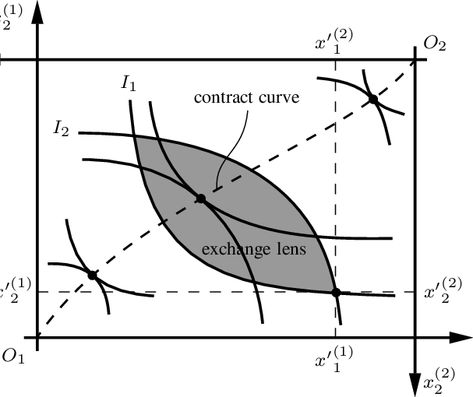
British Thought
Edgeworth box: mirrored immage of indifference curves for two individuals

Slide 7
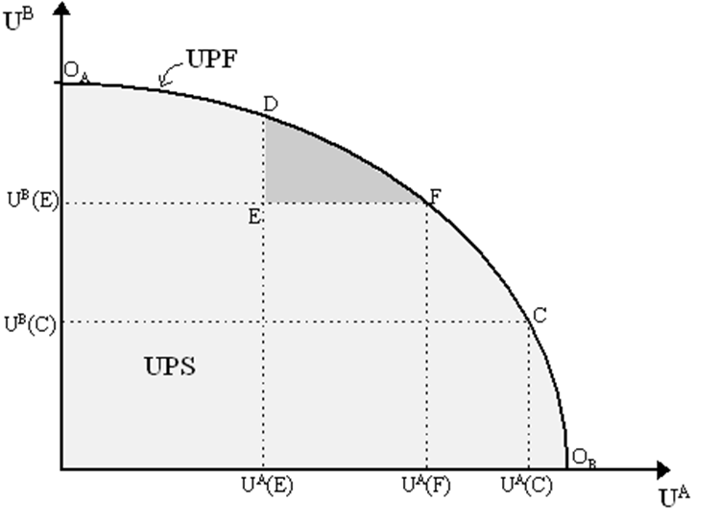
British Thought
Link between the contract curve and the UPF

Slide 8
British Thought
Alfred Marshall (1842 – 1924)
1863 graduated in mathematics at Cambridge
Since 1884 elected professor of political economy at Cambridge, till 1908
1890 „Principles of Economics“: basic reference text for generations of students (8th edition in 1920)
1890: British Economic Association, Economic Journal

Slide 9
British Thought
Alfred Marshall (1842 – 1924)
1879 „The Economics of Industry“ (with Mary Paley)
Influence of Carl Frederick Gauss(1777-1855) and Adolphe Quetelet (1796 – 1874): shift from the classical notion of natural prices to normal values (of prices, produced and exchanged quantities)
Influence of Charles Darwin (1859 The Origin of Species), Jean Baptist de Lamarck (1744-1829) and Herbert Spencer (1820 – 1903)

Slide 10
British Thought
Alfred Marshall (1842 – 1924)
Partial equilibrium method
Very short (supply is given), short (capacity is given), long (capacity is variable), very long (variable technonogy and tastes of consumers) time horizons
Industries with decreasing, constant and increasing returns to scale
Representative firm – evolutionary approach, based on the life-cycle of family firms

Slide 11
British Thought
Alfred Marshall (1842 – 1924)
1923 „Money, credit and commerce“
Cambridge equation M=kPY: shift from the Irving Fisher´s quantity equation Mv=PQ to money demand

Slide 12
British Thought
Arthur Cecil Pigou (1877 – 1959)
Successor of Marshall to the economics chair at Cambridge (1908 – 1943)
Elaborated the partial equilibrium analysis of short and long period based on U-shaped cost curves
Opened a new field of theoretical research – welfare economics:
analysis of external economies and diseconomies and of desirability of public interventions, extended use of the notion of consumer surplus
Pigou x Keynes: Pigou 1933 „Theory of Unemployment“, Keynes 1936 „General Theory“

Slide 13
British Thought
Lionel Robbins (1898 – 1984)
Graduated from the London School of Economics, full professor there from 1928 – 1960
1935 „An Essay on the Nature and Significance of Economic Science“
Rejects the former definitions based on production, distribution, exchange and consumption of wealth
Economics studies human behaviour as a relationship between ends and scarce means which have alternative uses

Slide 14
American Thought
John Bates Clark (1847 – 1938)
Graduated at Amherst in 1872
Postgradual work in Germany and Switzerland
Professor at Columbia University in New Yourk since 1895
1885: involved in creating the American Economic Association
1886 „The Philosophy of Wealth“
1899 „The Distribution of Wealth“
Marginalist theory of distribution
(Wicksteed in Great Britain, Wicksell in Sweden)

Slide 15
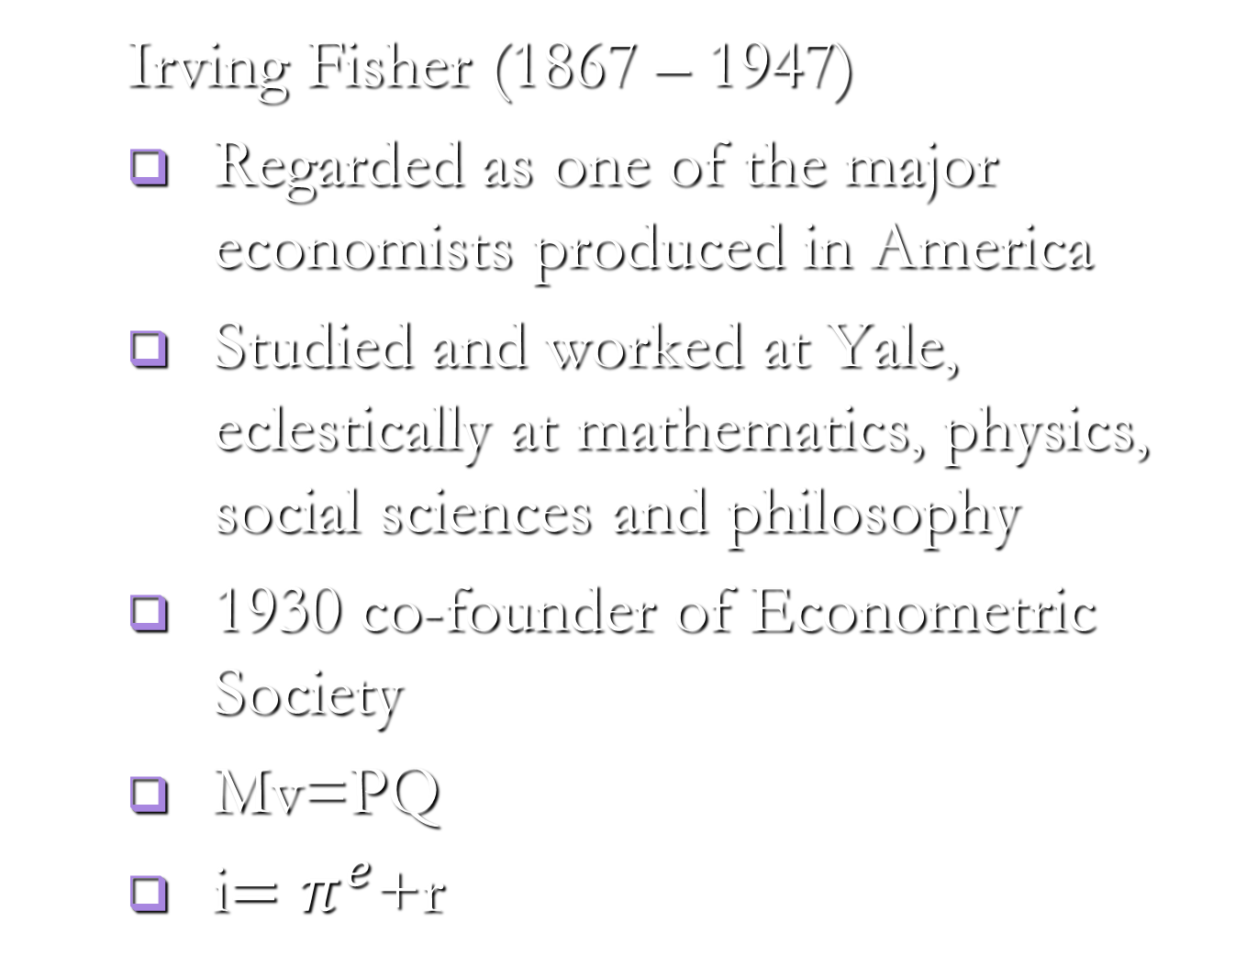
American Thought

Slide 16
Swedish School
Knut Wicksell (1851 – 1926)
Neo-Malthusian polemicist, freelance lecturer and journalist, professor in Lund, Sweden from 1899
1887 gained a scholarship abroad, London, Strasbourg, Vienna (Menger and Boehm-Bawerk), Berlin
Swedish School: Gunnar Myrdal, Bertil Ohlin and others, development of various aspects of Wicksell´s theory and use of tools of sequential analysis (Keynes rejected sequential analysis)

Slide 17
Swedish School
Knut Wicksell (1851 – 1926)
1893: essay „Value, capital and rent“:
A few years before Wicksteed: income distribution among factors of production based on their marginal productivities
Aggregated notion of capital based on the theory of the average period of production of Bohm-Bawerk
Later switched to the disaggregated notion of capital

Slide 18
The Theory of Market Forms
Antoine Augustin Cournot (1801 – 1877)
1838 – 1st formulation of the demand function
Theory of duopoly
Dissent from Marshall and Pigou
John Harold Clapham 1873 – 1946)
The 1st professor of economic history at Cambridge
1922 article in „The Economic Journal“ about empty boxes – it is impossible to idendify in relity industries with decreasing, constant or increasing returns to scale

Slide 19
The Theory of Market Forms
Piero Sraffa (1898 – 1983)
1925 article written in Italian specifying logical inconsistencies in the Marshallian theory of firm
1926 in English on the same subject – Sraffa was asked by Keynes to write it
What happens if single firms meet a decreasing demand curve? – This question opened further research about market forms
We will meet him again in the context of Postkeynesian economics

Slide 20
The Theory of Market Forms
Edward Chamberlin (1899 – 1967)
Harvard University in Cambridge, USA: PhD studies and full professor there from 1951 to 1966
Editor of the Quarterly Journal of Economics from 1948 to 1958
1933 „Theory of Monopolistic Competition“ (8th edition in 1962)

Slide 21
The Theory of Market Forms
Joan Robinson (1903 – 1987)
Born in Cambridge, studied at Cambridge and taught economics there, full professor in 1965, the first woman among the truly great economists
1933 „Imperfect Competition“: this provides the „vulgata“ for current textbooks on this topic
We will meet her again in the context of Postkeynesian economics

