Slide 1
Pricing of option contracts
Institute of Economic Studies
Faculty of Social Sciences
Charles University in Prague
Financial markets instruments
Notes:
Ztlumené efekty: 2,3,4
Odstranit srážku kamionu: snímek 8, 1:33 – 1:45

Slide 2
Binomial model (introduction)
Description
The binomial model derives its name from the binomial behaviour of the underlying asset
The price movement of the underlying asset is governed by the stationary binomial stochastic process: with a given probability the price can either increase or decrease by fixed jumps
Variables
$C$… price of a call option (to be determined)
$p, (1−p)$… probabilities of price increase and decrease (they are not independent variables)
$S$… current price of an underlying share (50 €)
$X$… exercise price (45 €)
$u$… fixed upward movement of the underlying’s price (1.3)
$d$… fixed downward movement of the underlying’s price (0.7)
$r$… risk-free interest rate (10%)
Binomial tree
Price movement of the underlying share
Price movement of the call option
$$u^{2}S$$
(84.5)
$$max⁡(0,u^{2}S−X)$$
(39.5)
$$uS$$
(65)
$$max⁡(0,uS−X)$$
(20)
$$S$$
(50)
$$udS$$
(45.5)
$$C$$
(???)
$$max⁡(0,udS−X)$$
(0.5)
$$dS$$
(35)
$$max⁡(0,dS−X)$$
(0)
$$d^{2}S$$
(24.5)
$$max⁡(0,d^{2}S−X)$$
(0)

Slide 3
Binomial model (key insights)
Delta-neutral covered call
A long stock is combined with such number of short calls that protects the value of the portfolio against price variations
Hedge ratio $h$ is a number of calls that makes the covered call delta neutral
Delta-neutral covered call
$$S→S_{u}⇒V_{u}=uS−hC_{u}=65−h×20$$
$h$ short calls
1 long stock
$$S→S_{d}⇒V_{d}=dS−hC_{d}=35−h×0$$
$${V_{u}=V}_{d}$$
$$V_{u}=uS−hC_{u}=dS−hC_{d}=V_{d}$$
$$S_{d}$$
$$X$$
$$S_{u}$$
$$S_{T}$$
$$h=\frac{uS−dS}{C_{u}−C_{d}}=\frac{65−35}{20−0}=\frac{30}{20}=1.5$$
$$V_{u}=V_{d}=35 €$$
Perfect market hypothesis
Present value of a risk-free financial instrument is equal to its future value discounted at a risk-free interest rate
Delta-neutral covered call is risk-free so its present value can be found by discounting its futures value using a risk-free discount rate
$$S−hC=\frac{V_{u}}{1+r}=\frac{V_{d}}{1+r}=\frac{35}{1.1}=31.82$$
$$⇨C=\left(S−\frac{V_{u}}{1+r}\right)×\frac{1}{h}=\left(50−\frac{35}{1+0.1}\right)×\frac{1}{1.5}=12.12 €$$

Slide 4
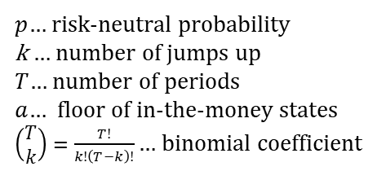
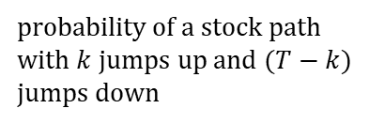
Binomial model (generalisation)
Risk-neutral probabilities
Fair price of a risky financial instrument can be found by discounting its expected value using a risk-free interest rate
$$S=\frac{E(S)}{1+r}=\frac{p×uS+\left(1−p\right)×dS}{1+r}$$
$p$… risk-neutral probability consistent with price movements of the underlying share
$$⇨p=\frac{\left(1+r\right)−d}{u−d}=\frac{1.1−0.7}{1.3−0.7}=66,67\%$$
Fair price of call option
$$C=\frac{E(C)}{1+r}=\frac{p×C_{u}+\left(1−p\right){×C}_{d}}{1+r}=\frac{0.6667×20+0.3333×0}{1.1}=12.12 €$$
Binomial model’s general formula
total probability
terminal payoff
$p$… risk-neutral probability
k … number of jumps up
$T$… number of periods
$a$… floor of in-the-money states
$\left(\begin{matrix}T \\ k\end{matrix}\right)=\frac{T!}{k!\left(T−k\right)!}$ … binomial coefficient
$$C=\frac{1}{{(1+r)}^{T}}\left[\sum_{k>a}{\left(\begin{matrix}T \\ k\end{matrix}\right)p^{k}{(1−p)}^{T−k}×\left(Su^{k}d^{T−k}−X\right)}\right]$$
probability of a stock path with $k$jumps up and $(T−k)$ jumps down
terminal stock price after $k$jumps up and $(T−k)$ jumps down
The formula for a European put can be written in an analogous way

Slide 5
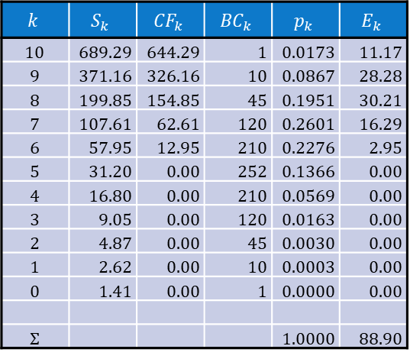
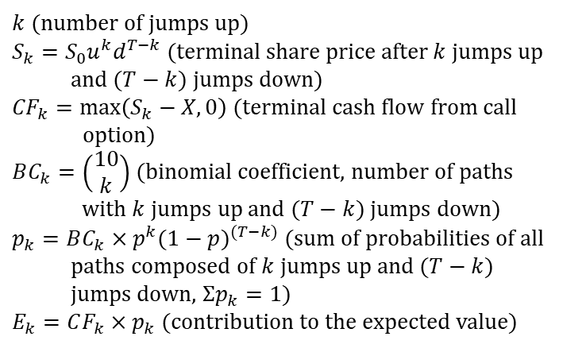
Binomial model (example)
Data
$S_{0}=50 €, X=45 €, u=1.3, d=0.7, r=10\% \text{per} \text{period}\text{ (}\text{same} \text{as} \text{on} \text{the} \text{slide}\text{ 2)}$
$T=10 years$ (model’s extension to 10 periods)
$p=66.67\%$(risk-neutral probability calculated on the previous slide)
Calculation
$$k$$ | $$S_{k}$$ | $${CF}_{k}$$ | $${BC}_{k}$$ | $$p_{k}$$ | $$E_{k}$$
10 | 689.29 | 644.29 | 1 | 0.0173 | 11.17
9 | 371.16 | 326.16 | 10 | 0.0867 | 28.28
8 | 199.85 | 154.85 | 45 | 0.1951 | 30.21
7 | 107.61 | 62.61 | 120 | 0.2601 | 16.29
6 | 57.95 | 12.95 | 210 | 0.2276 | 2.95
5 | 31.20 | 0.00 | 252 | 0.1366 | 0.00
4 | 16.80 | 0.00 | 210 | 0.0569 | 0.00
3 | 9.05 | 0.00 | 120 | 0.0163 | 0.00
2 | 4.87 | 0.00 | 45 | 0.0030 | 0.00
1 | 2.62 | 0.00 | 10 | 0.0003 | 0.00
0 | 1.41 | 0.00 | 1 | 0.0000 | 0.00
Σ |  |  |  | 1.0000 | 88.90
$k$ (number of jumps up)
$S_{k}=S_{0}u^{k}d^{T−k}$ (terminal share price after$k$jumps up and $(T−k)$ jumps down)
${CF}_{k}=\max\left(S_{k}−X,0\right)$(terminal cash flow from call option)
$BC_{k}=\left(\begin{matrix}10 \\ k\end{matrix}\right)$ (binomial coefficient, number of paths with $k$jumps up and $(T−k)$ jumps down)
$p_{k}=BC_{k}×p^{k}{(1−p)}^{(T−k)}$ (sum of probabilities of all paths composed of $k$jumps up and $(T−k)$ jumps down, $Σp_{k}=1)$
$E_{k}=CF_{k}×p_{k}$ (contribution to the expected value)
Mat. functions
→ COMBIN
$$C=\frac{\sum_{k}{E_{k}}}{{\left(1+r\right)}^{T}}=\frac{88.90}{{1.1}^{10}}=34.27 €$$

Slide 6
Black–Scholes formula
Assumptions
Derivation of the BS formula requires the knowledge of advanced techniques of mathematical calculus
Underlying price movements are subject to a stochastic differential equation
$$dS_{t}=μS_{t}dt+σS_{t}dW_{t}$$
Probability distribution of percentage price changes is subject to „bell-shaped“ normal distribution
$$f(x)=\frac{1}{σ\sqrt{2π}}e^{−{\left(x−μ\right)}^{2}/2σ^{2}}$$
$$N\left(x\right)=\int_{−∞}^{x}{f(z)dz}$$
$f\left(x\right)$… normal distribution function
$N\left(x\right)$… cumulative distribution function
Percentage price changes are approximated by logarithms of price indexes
$$\frac{∆S_{t}}{S_{t}}=\frac{S_{t+1}}{S_{t}}−1\dot{=}ln\frac{S_{t+1}}{S_{t}}$$
European call on non-dividend paying stock
$$C=f(S,X,T,r,σ)$$
$C$… premium of European call option
$S$… current price of an underlying stock
$$C=SN\left(d_{1}\right)−Xe^{−rT}N(d_{2})$$
$X$… exercise price of the option
$$d_{1}=\frac{\ln\left(S/X\right)+rT}{σ\sqrt{T}}+\frac{1}{2}σ\sqrt{T}$$
$T$… time to maturity of the option
$r$… risk-free interest rate
$$d_{2}=d_{1}−σ\sqrt{T}$$
$σ$… volatility (standard deviation) of percentage price changes of the underlying stock

Slide 7
Black–Scholes formula (example)
Data
$S_{0}=50 €, X=45 €, u=1.3, d=0.7,T=10 periods,r=10\%,$
$$p=66.67\%\text{ (}\text{same} \text{as} \text{in} \text{the} \text{extended} \text{binomial} \text{model}\text{)}$$
Calculation of the price volatility (standard deviation of price changes)
$$μ=p×\ln{u}+\left(1−p\right)×\ln{d=0.6667×\ln{1.3+0.3333×\ln{0.7=0.056}}}$$
$$σ^{2}=p×{\left[\ln{u−μ}\right]}^{2}+\left(1−p\right)×{\left[\ln{d−μ}\right]}^{2}$$
$$=0.6667×{\left[\ln{1.3−0.056}\right]}^{2}+0.3333×{\left[\ln{0.7−0.056}\right]}^{2}=0.0852$$
$$σ=\sqrt{σ^{2}}=0.292$$
Calculation of the call option premium
$$d_{1}=\frac{\ln\left(S/X\right)+rT}{σ\sqrt{T}}+\frac{1}{2}σ\sqrt{T}=\frac{\ln\left(50/45\right)+0.1×10}{0.292\sqrt{10}}+\frac{0.292}{2}×\sqrt{10}=1.6592$$
Stat. functions
→ NORM.DIST
$$N\left(d_{1}\right)=N\left(1.6595\right)=0.9515$$
$$d_{2}=d_{1}−σ\sqrt{T}=1.6592−0.292\sqrt{10}=0.7365$$
$$N\left(d_{2}\right)=N\left(0.7365\right)=0.7693$$
$$C=SN\left(d_{1}\right)−Xe^{−rT}N\left(d_{2}\right)=50×0.9515−45e^{−0.1×10}×0.7693=34.84 €$$
Volatility
(𝟑𝟒.𝟐𝟕 in BM)
Historical volatility: calculated as standard deviation of historical price changes of the underlying asset
Implied volatility: numerically extracted from the BS formula given all other variables are observable

Slide 8
Black–Scholes formula (expected value)
Expected value formula
On efficient markets, current price of a financial instrument is equal to the present value of the expected cash flow generated by this instrument
$$C=e^{−rT}\left[E(S_{T}|S_{T}>X)×P{(S}_{T}>X)−E(X|S_{T}>X)×P{(S}_{T}>X)+0×P{(S}_{T}≤X)\right]$$
$=e^{−rT}×E(S_{T}|S_{T}>X)×P{(S}_{T}>X)−X×e^{−rT}×P{(S}_{T}>X)$
Acquisition of a share and its value is conditional on the option being exercised
Expected value of a fixed exercise price is equal to this fixed amount
Interpretation of $N\left(d_{1}\right)$ and $N\left(d_{2}\right)$
$N\left(d_{2}\right): X×e^{−rT}×P{(S}_{T}>X)=Xe^{−rT}N\left(d_{2}\right)⇨N\left(d_{2}\right)=P{(S}_{T}>X)$
$N(d_{2})$ is equal to the probability that the option will be exercised
${N\left(d_{1}\right): e}^{−rT}×E(S_{T}|S_{T}>X)×P{(S}_{T}>X)=SN\left(d_{1}\right)$
$$⇨N\left(d_{1}\right)=\frac{E(S_{T}|S_{T}>X)}{S×e^{rT}}×P{(S}_{T}>X)=\frac{E(S_{T}|S_{T}>X)}{E(S_{T}) }×N\left(d_{2}\right)$$
$N(d_{1})$ is equal to the risk adjusted probability $N(d_{2})$
In risk-neutral environment expected return of each security is risk-free
$$⇨E\left(S_{T}\right)={Se}^{rT}$$
Conditional probability is always greater than the unconditional probability
⇨ $E(S_{T}|S_{T}>X)$> $E\left(S_{T}\right)$ ⇨ $N(d_{1})>N(d_{2})$

Slide 9
Extensions of BS formula (1)
European put on non-dividend-paying stock
Put-call parity (will be derived later)
$$C+Xe^{−rT}=P+S$$
$P$… premium of European put option
$$P=C+Xe^{−rT}−S=Xe^{−rT}\left(1−N\left(d_{2}\right)\right)−S\left(1−N\left(d_{1}\right)\right)$$
$$=Xe^{−rT}N\left({−d}_{2}\right)−SN\left({−d}_{1}\right)$$
American call on non-dividend-paying stock
Rational trader would never exercise the option prior to expiration date because better alternative is to sell the option and seize not only the option’s intrinsic value but also its time value
American feature has no added-value, so the BS formula for European call on non-dividend-paying stock can be applied
American put on non-dividend-paying stock
It may be rational to exercise the option earlier if the loss of the option’s time value is more than offset by the gain from putting the selling price into a risk-free account
American feature is more valuable than the European counterpart
Up to now, there is no closed-form solution for pricing this put option

Slide 10
Extensions of BS formula (2)
European call on dividend-paying stock
Decomposition of the stock price
risk-free component: present value of all dividends during the life of the option at a risk-free interest rate (the amount and timing of dividends can be predicted with certainty)
risky component: remaining value of the stock price (following random walk) whose volatility can be expected to coincide with volatility of the total stock price
BS formula can be used provided that the stock price is replaced by its risky component
American put on dividend-paying stock
Exercising the option before ex-dividend day: the option’s holder earns interest from depositing the selling price but loses the dividend
Exercising the option after ex-dividend day: the option’s holder forgoes interest from depositing the selling price and receives the dividend
One can benefit from the American feature and exercise the option earlier depending on the relative sizes of the gains and losses
Up to now, there is no closed-form solution for pricing this put option

Slide 11
Volatility smile
Description
Volatility smile is an empirical relationship between volatility of an asset and the exercise price of the option written on this asset
$$σ$$
normal distribution
empirical distribution
$$X$$
Volatility smile is not consistent with the BS formula because volatility is an attribute of an underlying asset (all options written on a given asset should have the same volatility regardless of the size of the exercise prices)
Volatility smile is a response to poor estimation results of the BS formula when applied to deeply out-of-the money and in-the money options (normal distribution tends to underestimate tail events)
Volatility term structure
Empirical relationship between the option’s volatility and its time to maturity (another inconsistent feature in the BS formula)
Inconsistency with the BS formula (all options written on a given asset should have the same volatility regardless of the time to maturity)

Slide 12
Put-call parity (1)
Description
Put-call parity links together premiums of European call and put options
Assumptions: the same underlying asset $S$, the same exercise price $X$ and the same time to expiry $T$
Perfect financial markets that do not allow arbitrage opportunities
Derivation
Participating portfolios
portfolio A: European call & cash $Xe^{−rT}$
portfolio B: European put option & underlying asset
Expiration values of portfolio A
$S_{T}>X⇨V_{A}=S_{T}$ (the cash accrues to an amount of $X$ and is used for buying the asset at the call’s exercise price)
$S_{T}<X⇨V_{A}=X$ (the cash accrues to an amount of $X$ but the call is worthless)
Expiration values of portfolio B
$S_{T}>X⇨V_{B}=S_{T}$ (the put is worthless and the asset is retained)
$S_{T}<X⇨V_{B}=X$ (the asset is sold at the put’s exercise price
Identical future payoffs imply identical current values on efficient markets
$$C+Xe^{−rT}=P+S$$

Slide 13
Put-call parity (2)
1
Graphical representation
$$C+B$$
$$P+S$$
$$V_{ }$$
$$V_{ }$$
long stock
long bond
long call
long put
$$X_{ }$$
$$S_{T}$$
$$X_{ }$$
$$S_{T}$$
the cash amount $X$ can be interpreted as a payoff from a risk-free zero-coupon bond $B$
Synthetic call and put options
$C=P+S−B$ (the payoff of a long call can be achieved by the combination of a long put, long stock and short bond)
$P=C+B−S$ (the payoff of a long put can be achieved by the combination of a long call, long bond and short stock)

Slide 14
See you in the next lecture
© O.D. Lecturing Legacy

