Slide 1
NEGOTIATION - REDSTONE
5 March 2024
Pavlína Vágnerová

Slide 2
REDSTONE DEVELOPMENT NEGOTIATION
Real estate development negotiation
Angela Redstone, great granddaughter of the founder of the city of Redstone, has proposed to build a luxury condominium project in the downtown.
A group of residents, the Downtown Neighborhood Association, is upset about the proposed project, concerned that it will elevate property values and taxes beyond what current residents can afford.

Slide 3
REDSTONE DEVELOPMENT NEGOTIATION
John Hammond, head of the Association, will be meeting with Angela Redstone. The Association would like to reduce the scale of the proposed project and to ensure that some units are reserved for residents of modest means (e.g., "affordable housing").
Angela Redstone wants to build more units than current zoning allows.

Slide 4
REDSTONE DEVELOPMENT NEGOTIATION
Logistics
20 min preparation (done at home)
30 – 45 min negotiation
debriefing

Slide 5
SCORES?
maximum possible score for Angela:
93 (80 housing units, 24 units of affordable housing).
John Hammond's maximum score:
55 (70 housing units, 23 units of affordable housing).
15 possible agreements
What is the contraint for Angela?
total units must be three times as many as the affordable units (eliminates some agreements that would otherwise exceed the parties' BATNA)

Slide 6
AGREEMENT?
What happened in the groups that got agreement vs. groups that didn‘t?
Strategy of the high scorers?
Low scores - what happened?
What did you learn?

Slide 7
LACK OF AGREEMENT AND LESSONS
Could be due to:
Unreasonable expectations: one or both parties set a target that was too high, and didn't modify that expectation in light of the information obtained during the negotiation.
Not exploring joint gains
Distributive vs. Integrative bargaining
Exploiting differences in values – possibilities of trades
Use of preferences (utilities) to create mutually advantageous trades

Slide 8
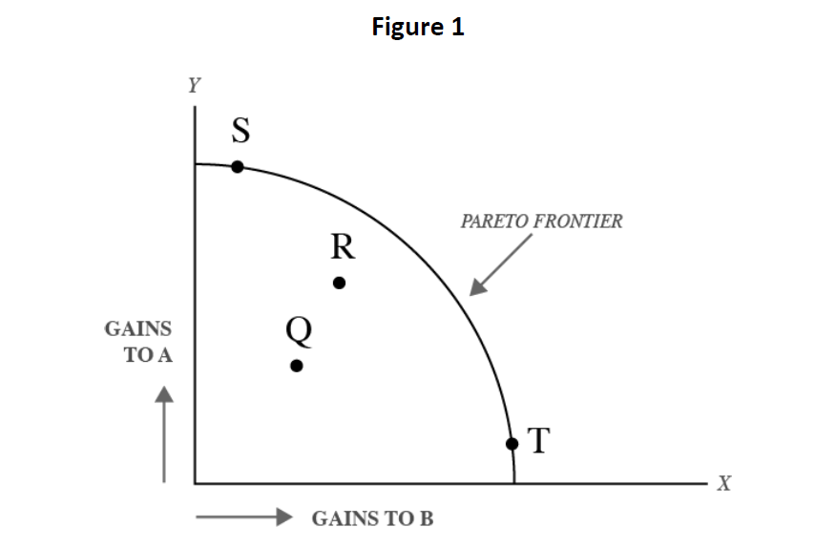
DISTRIBUTIVE VS. INTEGRATIVE BARGAINING
?

Slide 9
DISTRIBUTIVE VS. INTEGRATIVE BARGAINING
When is an agreement inefficient?
In distributive bargaining
In integrative bargaining
How can you move closer to the frontier?
„Creating“ aspect of negotiation vs. „claiming“ aspect
What would make each aspect easier? Would it effect the other?
Careful - real negotiation includes both! (know when to compete and when to create)
Take your time with the 1st offer!
Notes:
DISTRIBUTIVE: anchoring – concessions . Package
INTEGRATIVE: start (small talk, respect other) – invent options – take time – general framing (combine specific aspects of the deal and general notes) – evaluate
WHAT SHOULD YOU DO IF THE OTHER MAKES EXTREME HIGH EXPECTATIONS?
Dont také it seriously (make a joke)
Tell its out of line and we cant consider it
Sk him to revisit it, (and never refer to it)
Better to go back to interests

Slide 10
USE OF UTILITIES TO MAKE TRADE-OFFS
When/why are joint gains possible?
Parties are rarely identical in their tastes, (time) preferences, capabilities, risk aversion and resources!
Complex negotiation is a circle (continuous evaluation, preparation, negotiation and information gathering)
Of course – specifying utilities in a game creates limitations
Which limitations, what are the consequences?
Why did the authors use utilities in this way?

Slide 11
BATNA, reservation price, ZOPA
BATNA
Recap from last lesson – what it is?
When you have a strong BATNA… and when you have a weak BATNA…
Improve your BATNA
Know the other‘s BATNA and weaken it
Reservation price
Point of walk away
ZOPA
Area between 2 parties‘ reservation price
Notes:
Recap from last lesson – what it is?
When you have a strong BATNA… make sure other side knows it!
When you have a weak BATNA… fake it?

