Slide 1
Online classes
Patient 5.
MUDr. Bílková Simona, Internal Department II Faculty of Medicine in Pilsen

Slide 2
Your patient on acute ambulance is a young woman, 33 years old, obesitas, until now withnout disease.
In the last 2 weeks she has nausea, vomiting, lost weight, she has an increased feeling of thirst and a lot of urine and she feels very tired.

Slide 3
what examination will you do?
what is your differential diagnosis?

Slide 4
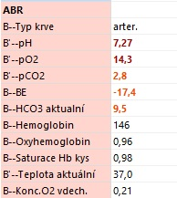
Laboratory results:
Glykemia: 30mmol/l .

Slide 5
What do you think about patinet´s laboratory results?
The following step should be:

Slide 6
what other examination will you perform?
do you give the patient any medication?

Slide 7
Is it …………………….(dg) of the first or second type? how do you know it?
what is the reason why a patient loses weight?

Slide 8
which therapy do you choose?
what recommendation do you give to the patient?
does the patient have to be hospitalized? if so, why.

Slide 9
HbA1c, is ……………………….
What do you know about this laboratory result?

Slide 10
What are the chronic complications of this disease?

Slide 11
Why we should be careful with insulin therapy in a patient with hypokalemia?
What do you know about the effect of insulin on potassium (kalium) levels?

Slide 12
Thank you for your answers ☺
Best regards ☺

