Slide 1
Building of the State Interewar Czechoslovak Society 1918-1918
prof. PhDr. Michal Stehlík, Ph.D.

Slide 2
Europe and the World 1914–1918
The old monarchies
Balance of powers
Ambitions of nations
Stability?

Slide 3
Europe and World 1914–1918
New ideas
New powers
The right of nations to self-determination 0 – how to interpret it?
Winners and losers

Slide 4
Austria-Hungary at the End of the War

Slide 5
Creation of Czechoslovakia
Foreign activity of TGM
Domestic policy
International situation
War
Legion
New concept of Europe
W. Wilson
1915 / 1916 / 1918

Slide 6
Declaration of Independence of the Czechoslovak Nation
The Czechoslovak state shall be a republic. In constant endeavor for progress it will guarantee complete freedom of conscience, religion and science, literature and art, speech, the press, and the right of assembly and petition. The Church shall be separated from the State.
Our democracy shall rest on universal suffrage. Women shall be placed on equal footing with men, politically, socially, and culturally. The rights of the minority shall be safeguarded by proportional representation; national minorities shall enjoy equal rights. The government shall be parliamentary in form and shall recognize the principles of initiative and referendum. The standing army will be replaced by militia.
The Czechoslovak Nation will carry out far-reaching social and economic reforms; the large estates will be redeemed for home colonization; patents of nobility will be abolished.
In its foreign policy the Czechoslovak Nation will accept its full share of responsibility in the reorganization of Eastern Europe. …
Our Constitution shall provide an efficient, rational, and just government, which will exclude all special privileges and prohibit class legislation.
Democracy has defeated theocratic autocracy. Militarism is overcome – democracy is victorious; on the basis of democracy, mankind will be reorganized. The forces of darkness have served the victory of light – the longed-for age of humanity is dawning.
We believe in democracy, we believe in liberty – and liberty evermore.

Slide 7
Conception of the Newly Established State
The common state of Czechoslovak nation
Czechs, Slovaks, Ruthenians
Stability in Central Europe
A bulwark against German expansion
Ally of the West
Versailles…

Slide 8
Nations and Nationalities
Czechs: 6,5 million
Germans: 3,1 million
Slovaks: 2 million
Hungarians: 750 thousand
Ruthenians: 460 thousand
Jews: 180 thousand
Poles: 75 thousand
Newly created Czechoslovak nation: 8,5 million inhabitants…

Slide 9
The Idea and Entrenchment of the State
Democracy
Parliament
Belief in the nation state
Rejection of the nobility
Critical attitude towards the Church
MASARYK

Slide 10
Masaryk as a Phenomenon
Professor of Philosophy (born in 1850)
The case of Manuscripts, Hilsner affair before 1914
Individuality – the only member of his party…
Critical approach, democrat, US inspiration
Going to exile, success from individual activities
Icon – image of Masaryk
President until 1935, dies in 1937

Slide 11
Ideas vs. Reality
Borderland of Bohemia
Upper Hungary – Slovakia
Cieszyn Silesia
The principle of state law
The principle of self-determination

Slide 12
Nations and Nationalities
Czechs: 6,5 million
Germans: 3,1 million
Slovaks: 2 million
Hungarians: 750 thousand
Ruthenians: 460 thousand
Jews: 180 thousand
Poles: 75 thousand
Newly created Czechoslovak nation: 8,5 million inhabitants…

Slide 13
Politics and Public Space
Parliament – House of Commons and Senate
Multiple political parties – Czech hegemony
The “Five” system – agreement on basic matters outside parliament
Bound list of candidates…
Corruption
Ethnic friction…

Slide 14
Politics and Public Space
Land reform
National character
Use of history
30 % change in land tenure
Church
Criticism of Catholicism
Establishment of the Czechoslovak Church

Slide 15
Politics and Public Space
Public national festivities
Celebrations of Hus in 1925
St. Wenceslas Festival in 1929
Sokol – all-Sokol get togethers
Celebrations of President Masaryk's birthday
National differences
Slovaks
Germans

Slide 16
Politics and Public Space
Communist Party – since 1921, radicalisation - MOSCOW
Sudeten German Party – connection with the Nazis, elections in 1935 - BERLÍN
Hlinka's Slovak People's Party – Slovak desire for independence

Slide 17
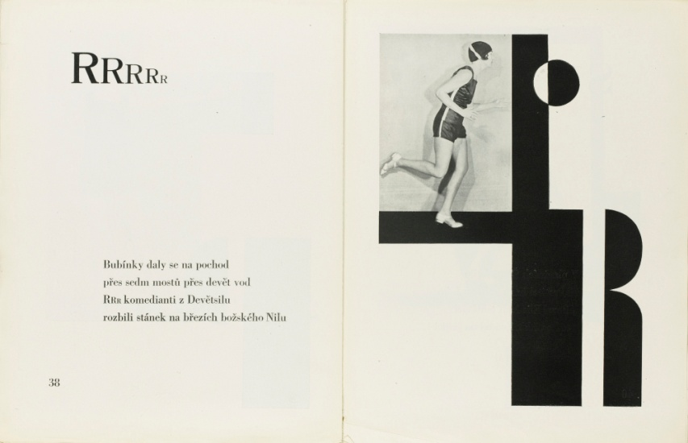
Culture
The boom of art, literature, architecture, sculpture, journalism, theatre, film, design
Orientation of the culture towards France
Participating in the world exhibitions – success in 1937
Radio broadcasting from 1923

Slide 18
Architecture in the First Republic
Jan Kotěra
Josef Gočár
Jan Zázvorka
Josip Plečnik – Prague Castle
Monuments of the Republic
Bradlo Hill – Štefánik
Memorial of Vítkov

Slide 19
Free Time
Spa
Mountains – Slovakia
Sport
Athletics
OLYMPIC GAMES
Football
1934
Hockey

Slide 20
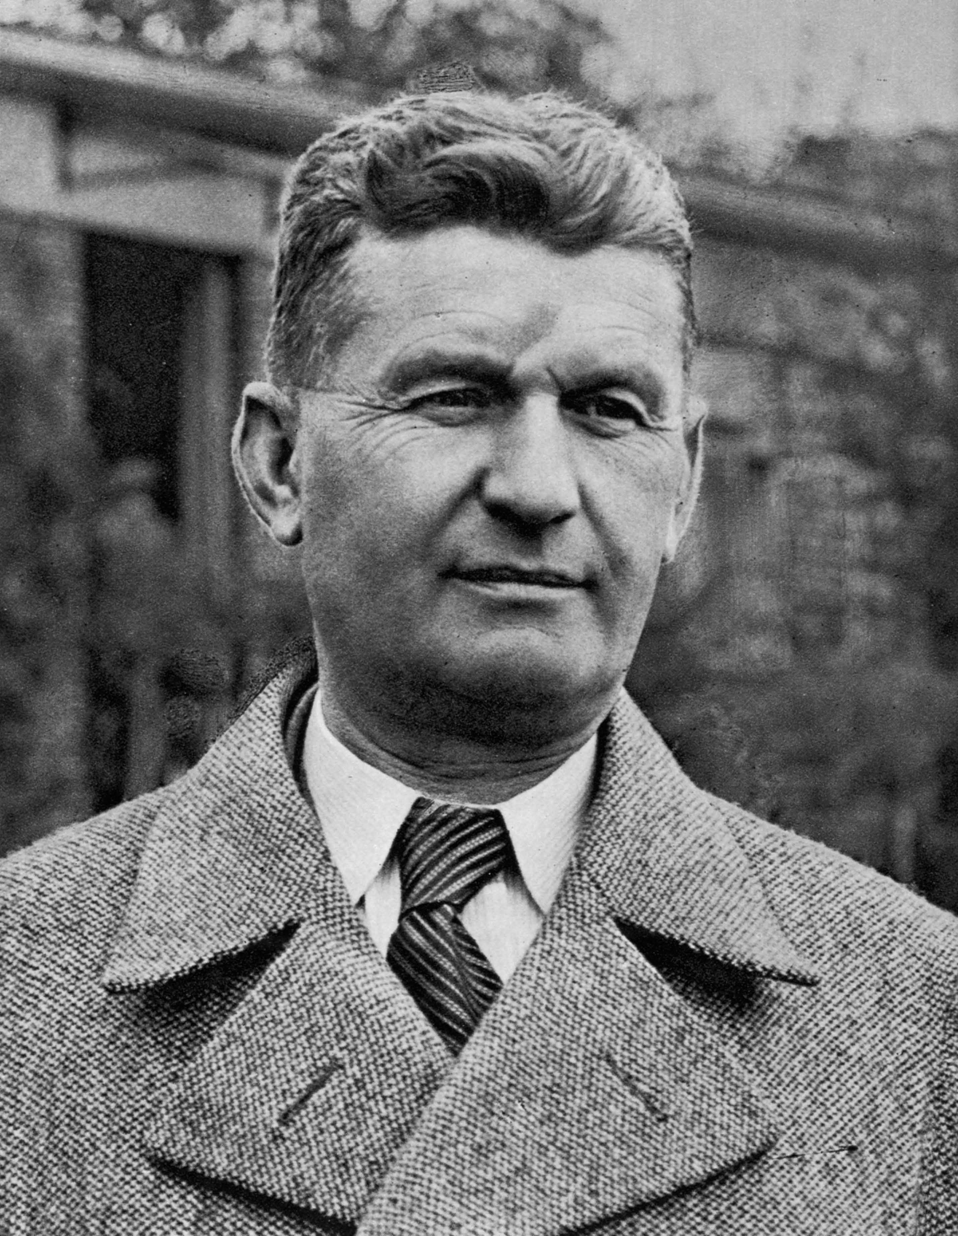
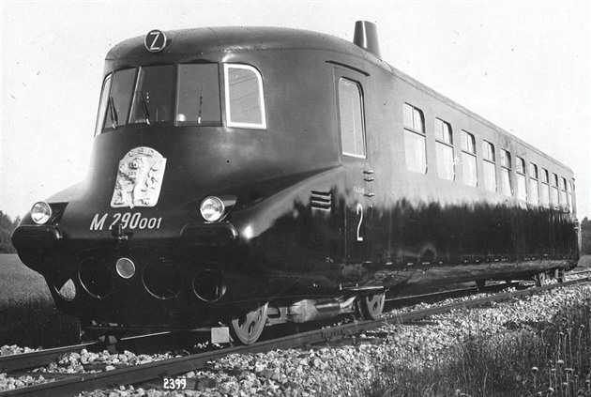
Economics
Crisis after 1918 – Alois Rašín, currency separation, strengthening of currency, new markets
Land reform
Economic development – engineering, trade, export, transport
Škoda in Pilsen, Bata in Zlín, Zbrojovka in Brno
Crisis of 1929-1933
Political crisis resulting from the economic crisis

Slide 21
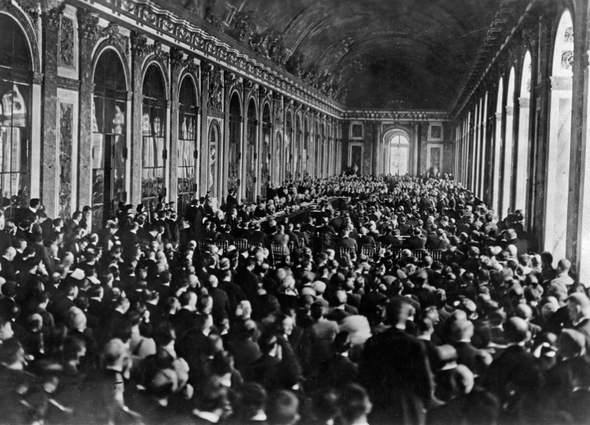
International Status
Versailles system
Saint Germain, 1919
Trianon, 1920
ALLIES: France, Great Britain
ALLIES IN THE REGION: Little Entente – Romania/Yugoslavia
ENNEMIES: Hungary, Germany
Role of the USSR…
Tensions: Poland

Slide 22
International Status
DEPENDENCE ON THE POST-WAR SYSTEM
CHANGE IN THE SITUATION LEADS INTO
(AND PUTTING THE SYSTÉM IN QUESTION)
– THE THREAT TO THE REPUBLIC
RELIANCE ON ALLIES
– FAITH IN DIPLOMACY

Slide 23
Economic and Political Crisis
Economy
Crisis after 1918
Crisis after 1929
Unemployment in 1933: 900.000 persons
Crisis after the separation of the border area in 1938, loss of natural space
Policy
Crisis of the state building – wars with Hungary, Poland, riots in Germany, fear of Hungary
Crisis of relations with the Slovaks after 1929, Pribina Festival in 1933, 1938
Crisis of relations with Germany after 1933, elections in 1935, crisis in 1938

Slide 24
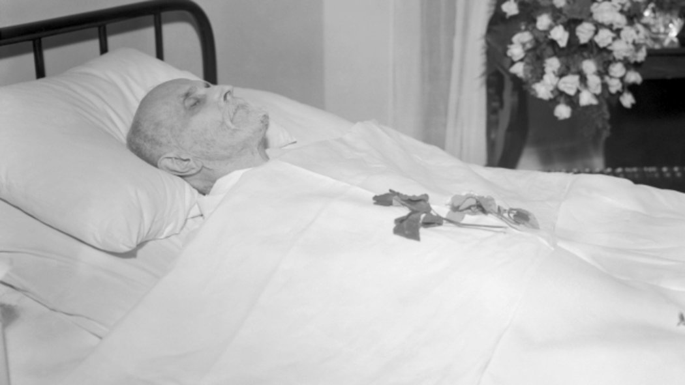
Masaryk’s Death – a Symbol
Abandoning the presidential election in 1935
Election of Edvard Beneš
Death on 14 September 1937
“TGM was still alive. In his seclusion, he seemed a more sure guarantee and a more reliable bulwark than as an active head of state: still living and turned into a guardian angel.”

Slide 25
Late 1930s…
The national question
SdP requirements, support of Germany
International diplomatic isolation – the reluctance of allies: “there is a strong feeling that we should not go into war over the CSR, which is very far away and with which we have little in common”
Runcimann’s mission in 1938
Mobilisation in 1938
International tensions
Munich Agreement on 30 September 1938

Slide 26
End of a Dream (and of a Conception)
Cession of the borderlands after the Munich Agreement
Acceptance – we did not fight
Second Republic – lack of trust in the democracy and the parliament
Antisemitism
Occupation in March 1939

Slide 27
Faith in the State

Slide 28
Soul of a Nation? … Jan Patočka
"In the chapter on self-confidence in the Phenomenology of Spirit, Hegel shows that a slave who finds his self-confidence in his master is formed by surviving and wanting to survive the shock of the fear of death.
Seen at large, this is the same thing that happened to us in 1938, not through a foreign dictate but through our subordination according to Benes's decision. Nothing can be dictated to the weak but defensible; it is his concern whether he wants to suffer and die or not.
It seems to me, therefore, that the Czechs, these liberated servants from above, have missed the opportunity to fight for their freedom additionally and independently..."

Slide 29
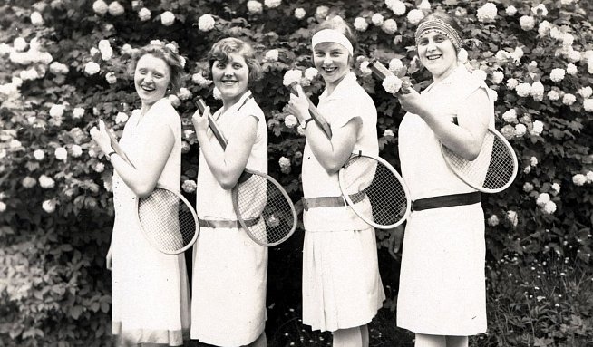
Legacy and Image of the First Republic
Legacy
Democratic system
The rule of law
Viable economy
Developed culture
Openness to the world
Image
An idealised world without any challenges
International Excellence
Masaryk is a Republic
We do not see corruption
We do not see economic and social issues
Idealisation – from about the mid-1950s (communist totalitarianism) until nowadays.

Slide 30
Czechoslovakia

