Slide 1
MEDITERRANEAN AND CENTRAL EUROPE
IN LATE IRON AGE
(LT C2–LT D)

Slide 2
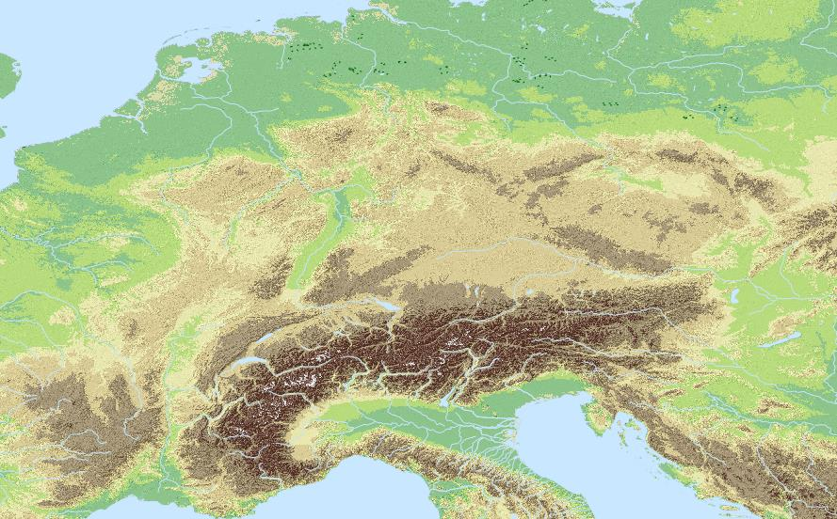
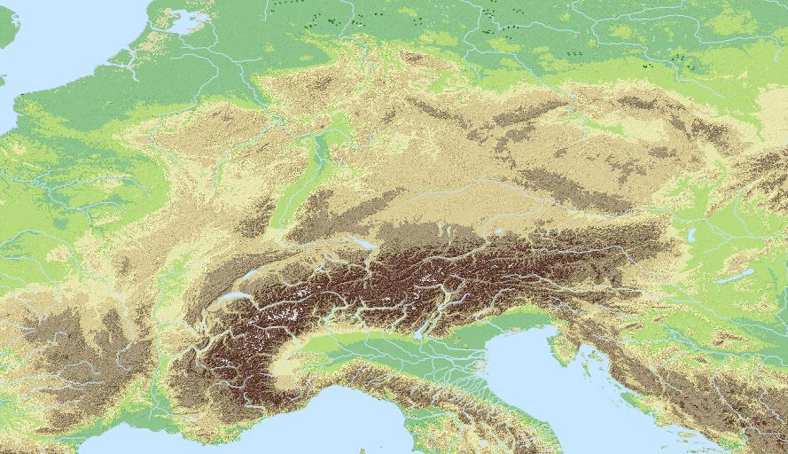
LTC1 – archeologically visible burials disappeared in most of Central Europe
from mid 3rd till 1st c. BC we have no idea what they did with the bodies…(well.. We guess but you don‘t want to know)
LT B–C1 cemeteries
LT C2–D cemeteries

Slide 3
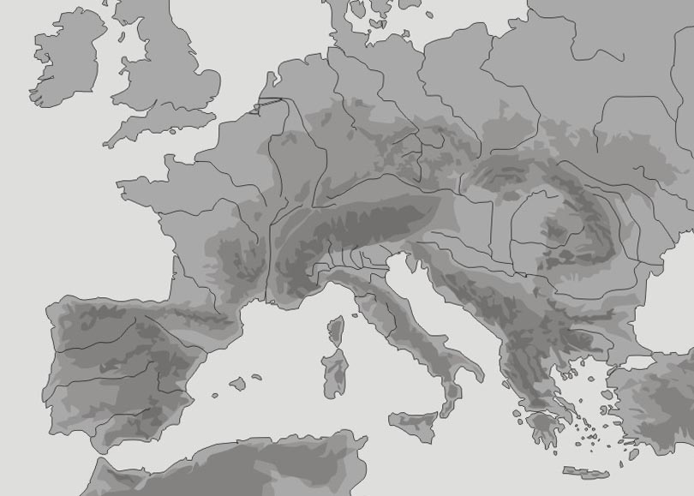
In LT C2–D (II–I century BC), LT culture stabilized itself in greater part of temperate Europe from the Pyrenes and Atlantic coast to the Carpathians

Slide 4
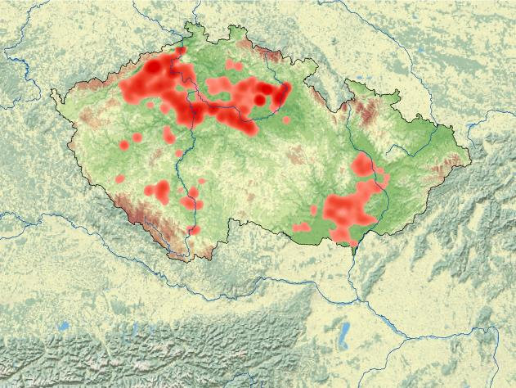
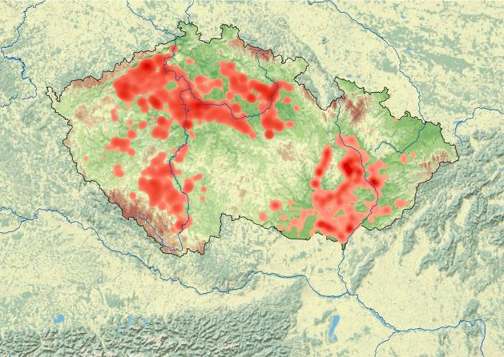
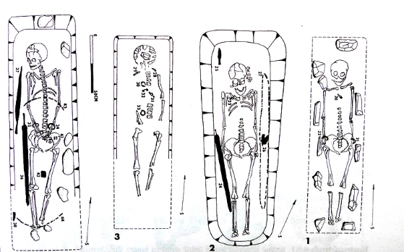
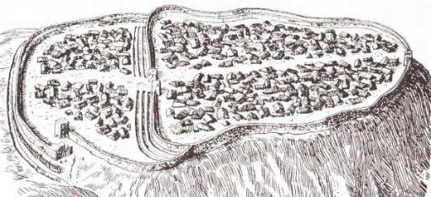
Until late 20th century, European archaeology distinguished…
… a Middle La Tène ‚flat grave period‘ (low social complexity, no central settlements, stress on burial evidence)
….and a Late La Tène ‚oppida period‘ (appearance of massive fortified central settlements, colonisation of new regions, huge technological and economic surge…).
-the seeming sudden transition and radical change from one of these phases to the other gave rise to hypotheses that it was due to strong cultural impact from the Mediterranean (e.g. Boii migrating from Italy… :~/ )

Slide 5
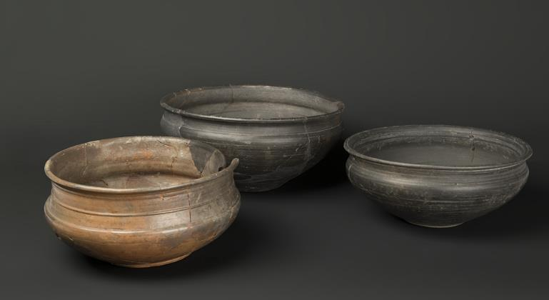
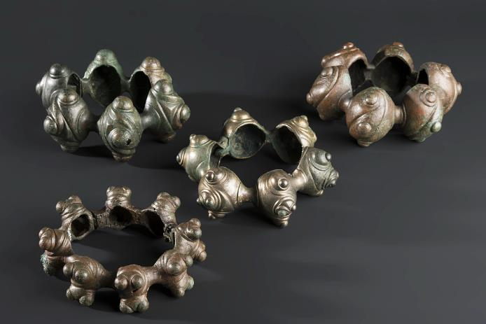
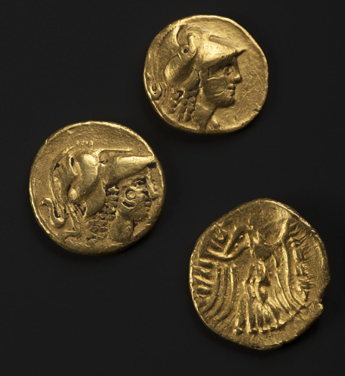
Moreover…
1) written sources clearly talk about massive presence of Celts in the Mediterranean in the III BC
2) some III BC innovations of the period are clearly of Mediterranean origin (coinage), other were declared of Mediterranean origin through circular argument… in some cases it was confirmed by later research (two-chambre pottery kiln certainly came from Greece… but not necessarily re-introduction of potter‘s wheel), other are only unconfirmed proposals (e.g. change in bronze smelting technology)
450 450
400 400
350 350
300 300
250 250
200 200
150 150
100 100
50 50
LT A
LT B1
LT B2
LT C1
LT C 2
LT D
FLAT GRAVES
Celtic invasion of Greece
PRE-OPPIDA period
The discoveries of the early 21st century showed that it was all a little more complicated: there was a key transitional phase of ‚pre-oppida period‘ in mid-III–II century BC and the role of Mediterranean on the transformations was not inexistent but not as direct as originally imagined.
OPPIDA

Slide 6
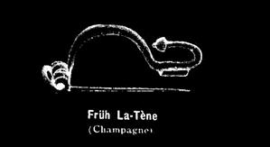
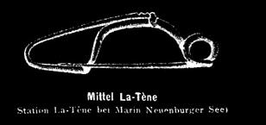
450 450
400 400
350 350
300 300
250 250
200 200
150 150
100 100
50 50
-PRINCELY BURIALS
-SOUTHERN IMPORTS
LT A
LT B1
LT B2
LT C1
LT C 2
LT D
-CELTIC EXPANSION
-FLAT BURIALS
-END OF BURIALS
-AGLOMERATIONS
-TECHNOLOGIES AND COINS
-OPPIDA

Slide 7
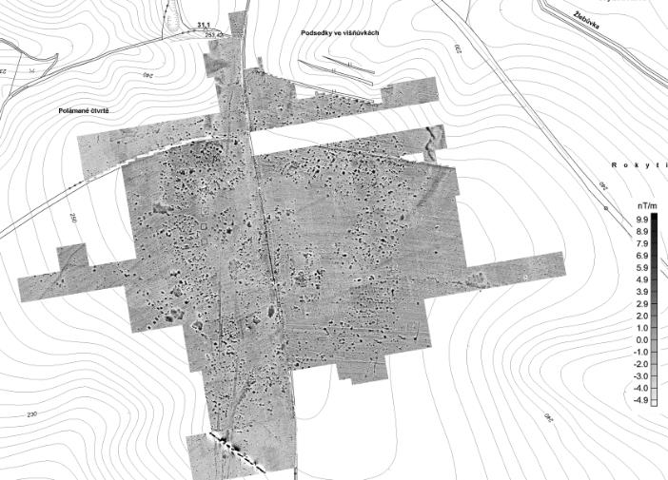
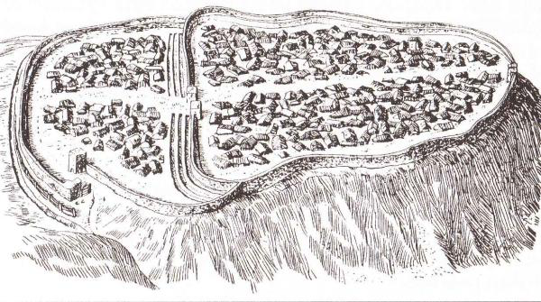
LT C–D is characterised by radical transformation of settlement pattern with sudden reappearance of central settlements
unfortified lowland agglomerations in LT C1–C2
fortified hilltop settlements („oppida“) in LT C2–D
-in both cases they cover surfaces of dozens (or hundreds of) hectars
-both concentrated crafts, trade, and central functions
LT C1
LT C 2
LT D
250 250
200 200
150 150
100 100
50 50

Slide 8
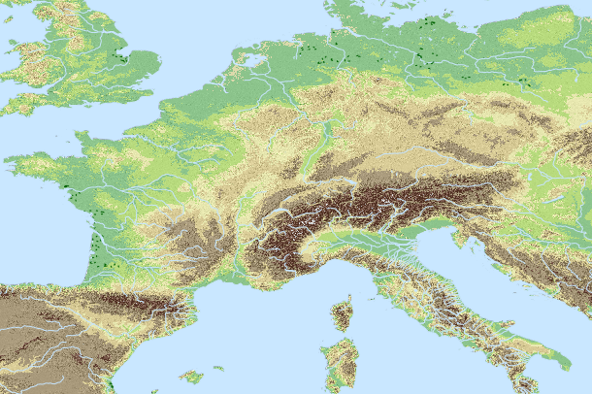
III–I c. BC LT agglomerations in Europe (some of them)
Principally LT C–C2
Principally LT C2–D
Nowa Cerekwia
Němčice n.H.
Bobigny
Manching
Roseldorf
Lacoste

Slide 9
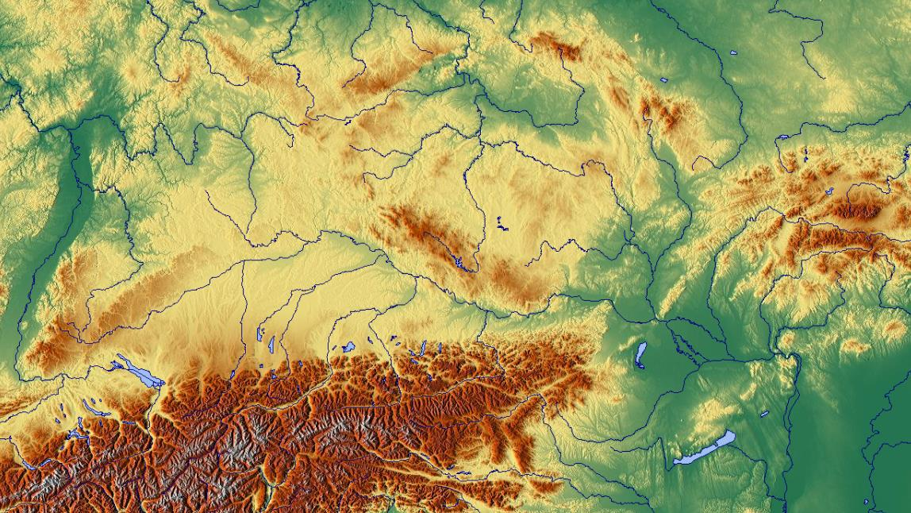
„the amber route corridor“
Nowa Cerekwia
Němčice nad Hanou
Manching
Roseldorf

Slide 10
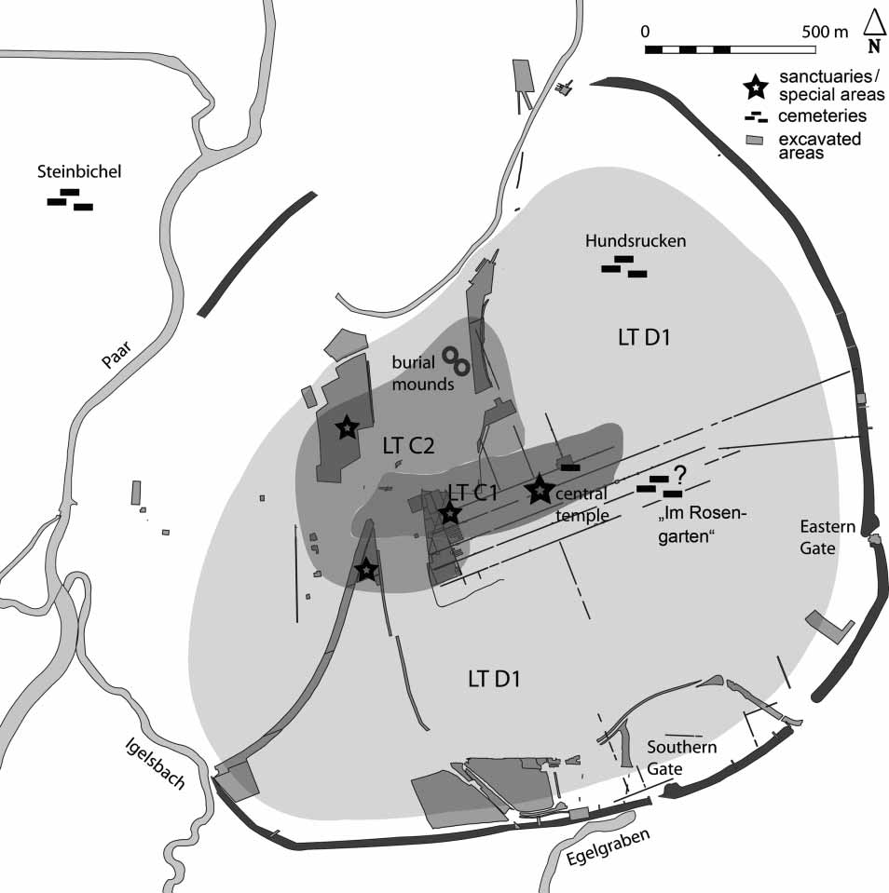
Manching
-development from a LT C agglomeration to a LT D oppidum (after a rampart was built in II/I BC)
Nowa Cerekwia
Němčice nad Hanou
Manching
Roseldorf

Slide 11
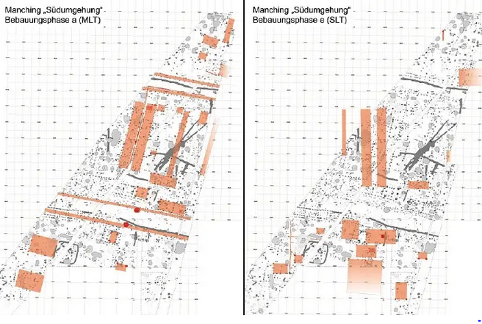
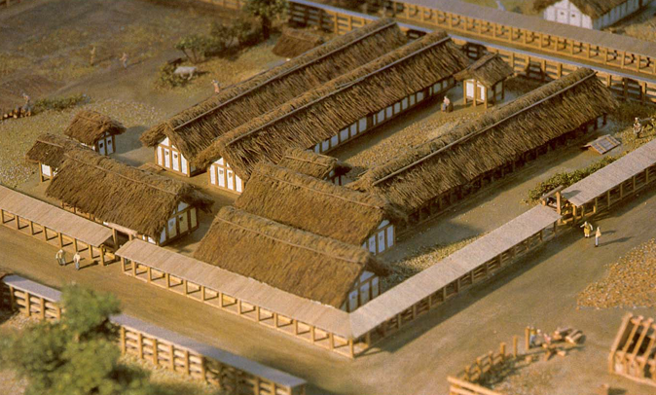
Already in the LT C phase, the inner area of Manching was densely built-up with imposing buildings and a unitary street grid defining the orientation of all buildings
The unitary street/building orientation was maintained throughout Manching‘s existence.
The orientation was changed several times by a few degrees resulting in rebuilding the entire central part of the settlement according to the new grid.

Slide 12
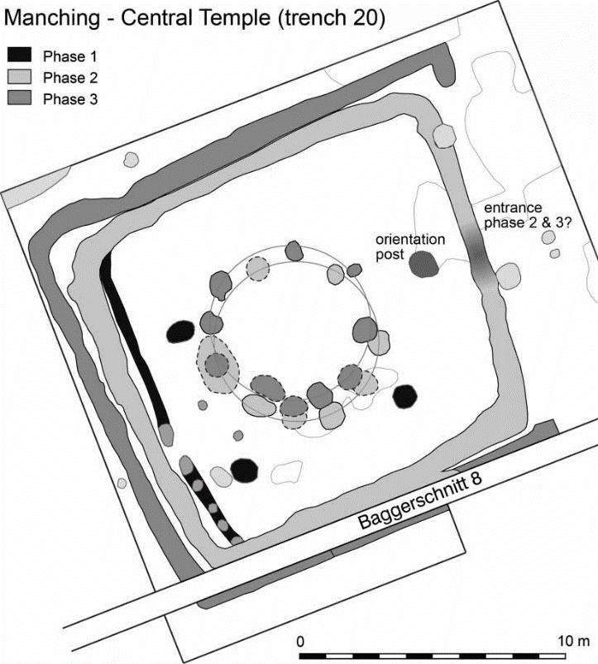
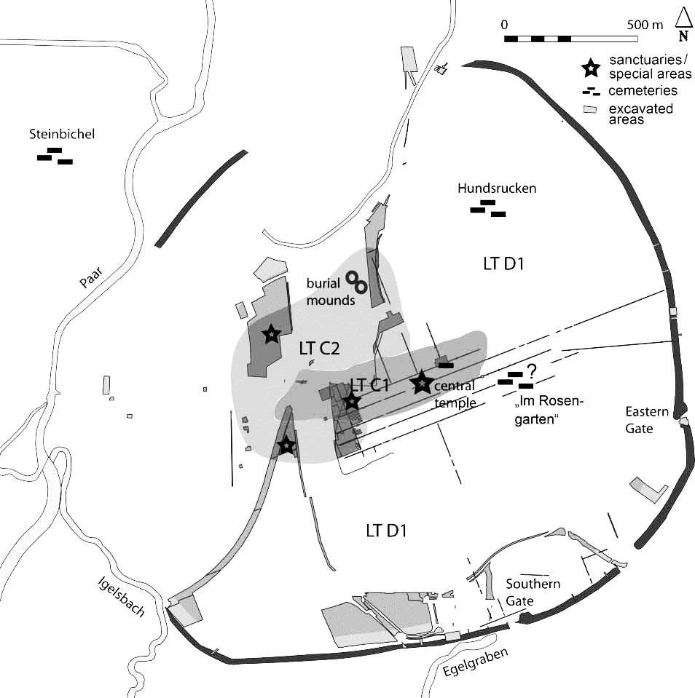
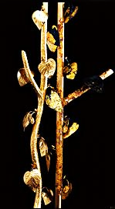
Manching – central sanctuary
-in the centre of the settlement throughout its existence
-the shifts of urban grid correspond with orientation of different phases of the sanctuary (apparently it will also be the reference point for the later plannig of the rampart)

Slide 13
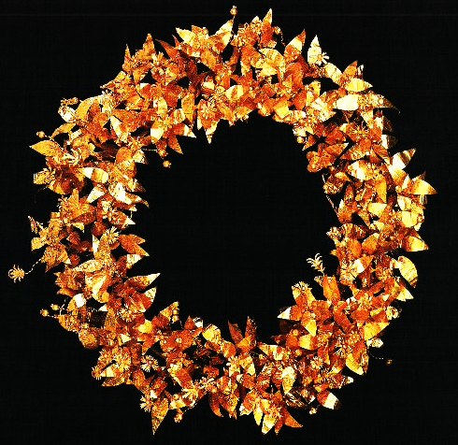
Manching – central sanctuary
-the findspot of a model tree made of sheet gold
-tree models made of metal did appear in Mediterranean sanctuaries
-the technology of making vegetal elements out of sheet gold has direct analogies in the Greek world

Slide 14
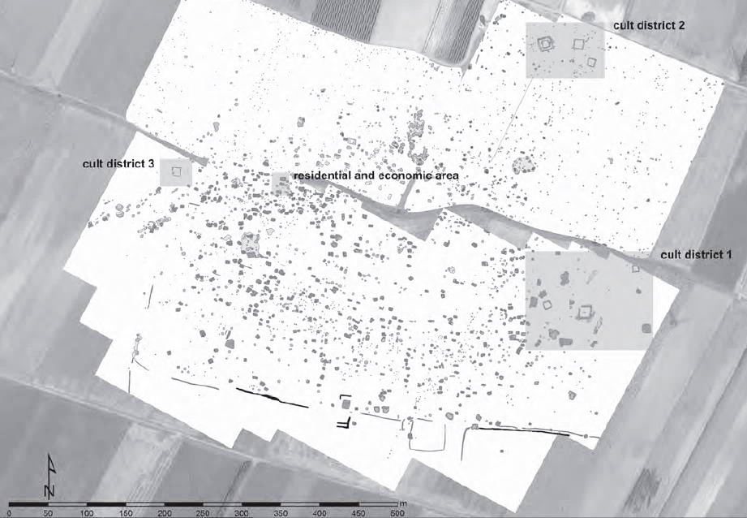
Roseldorf
-Sandberg
40 ha
LT B2/C1–C2 (probable continuity to LT D is not well defined)
>1500 coins (officially discovered but unpublished + thousands unofficially discovered coins… also unpublished if you wondered)
3 cult areas (which is the only thing that is excavated)

Slide 15
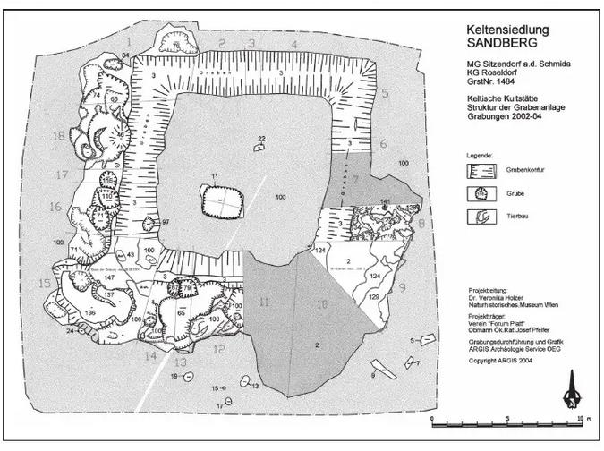
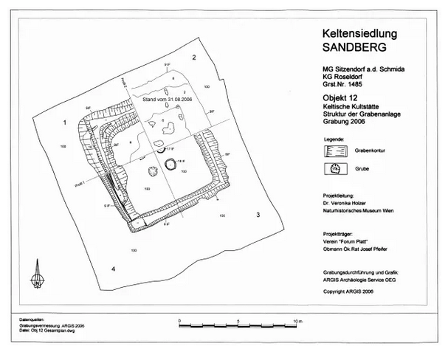
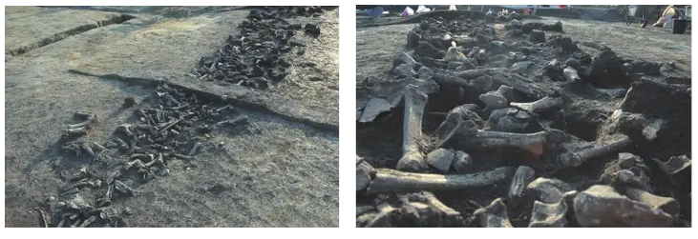
Sanctuaries = square enclosures with ditches around
-remains of collective banquets = places of ritual feasting

Slide 16
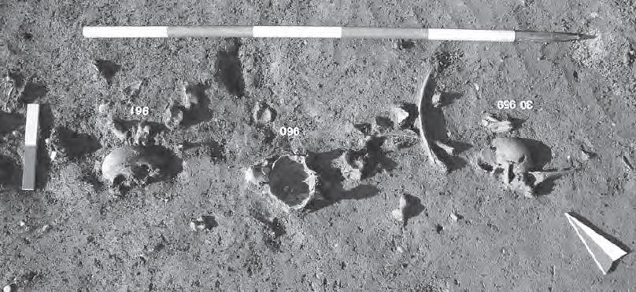
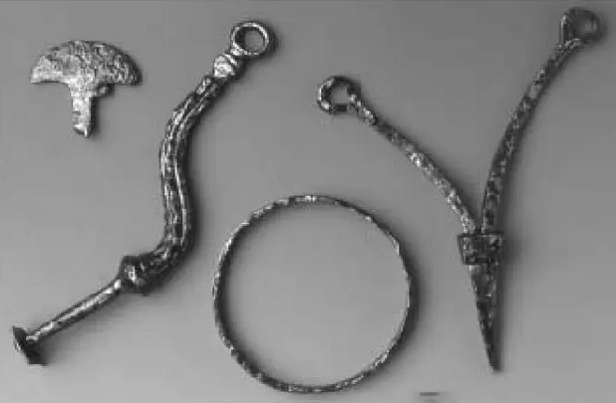
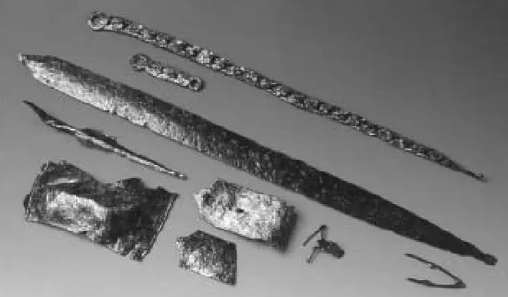
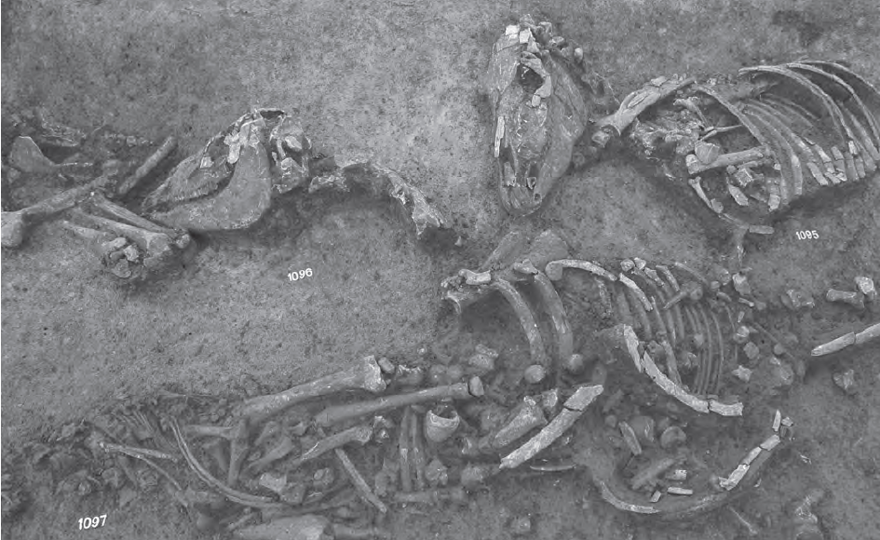
-human and horse remains, weaponry and chariot parts
=> Sacrificed spoils of war

Slide 17
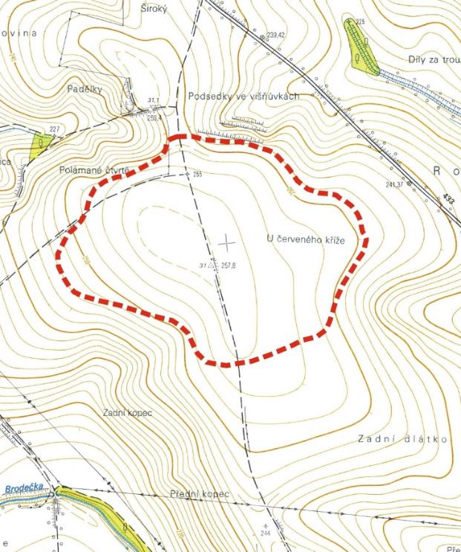
Němčice nad Hanou

Slide 18
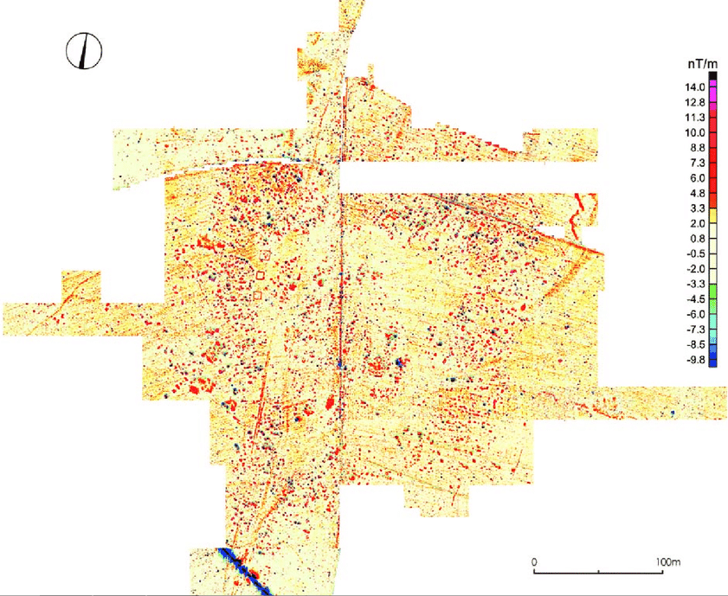
-36 ha
-LT B2/C1–C2 (no LT D continuity)
-geophysics, surface survey (legal and mostly illegal), not a single exacavation
-occupation around an open central area
-a series of enclosures (sanctuaries?) along one side
-1200 published coins (ca 20 000 – 30 000
discovered coins, most of them lost) (more on them later)

Slide 19
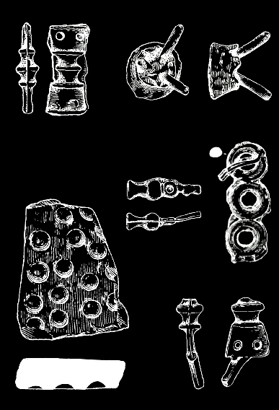
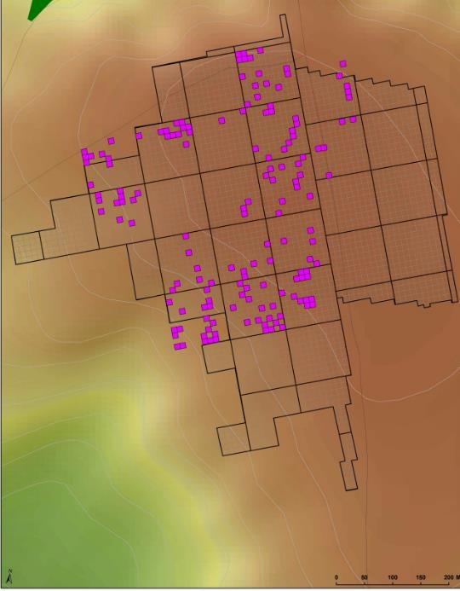
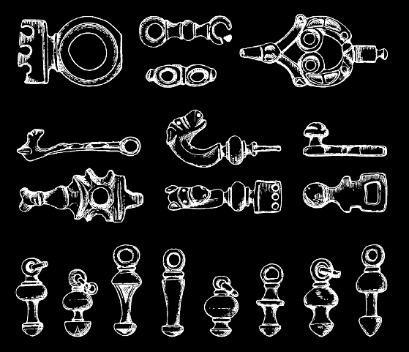
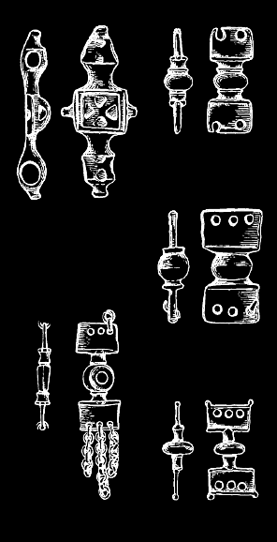
-massive evidence of bronze working all over the settlement
- production waste
-insanely rich collection of bronze artefacts, most of them probably locally produced
-belt elements…….

Slide 20
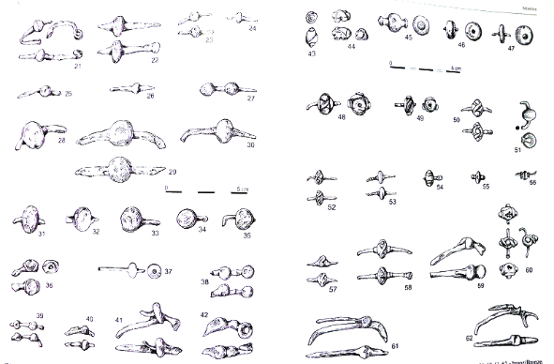
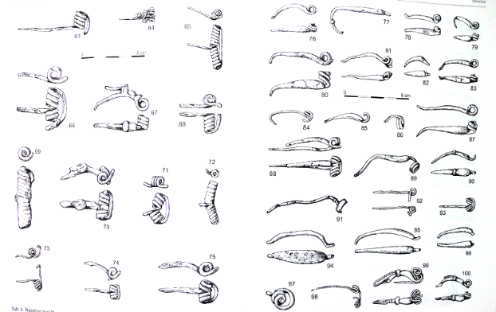
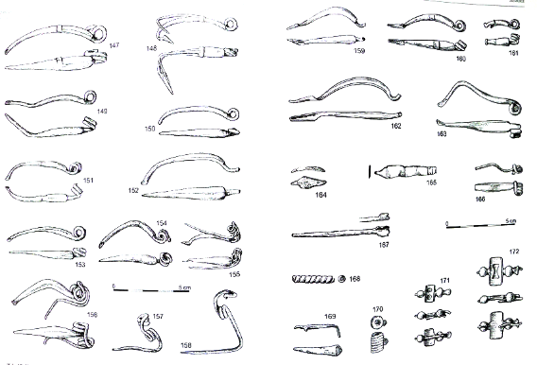
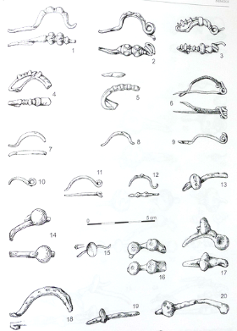
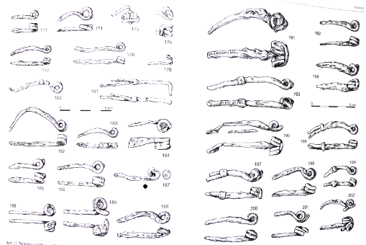
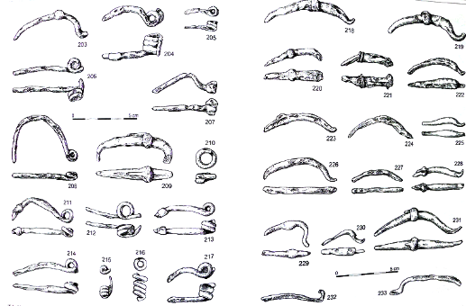
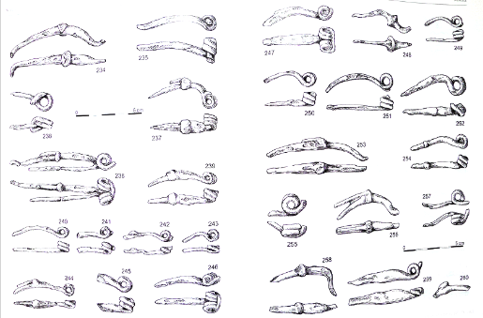
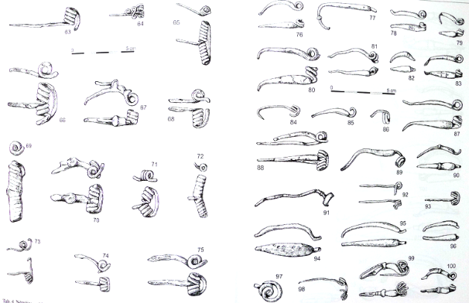
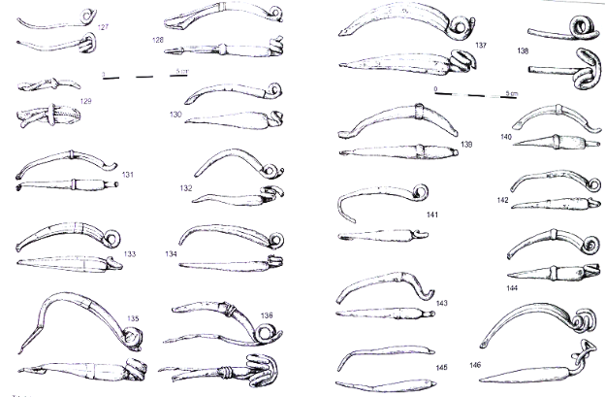
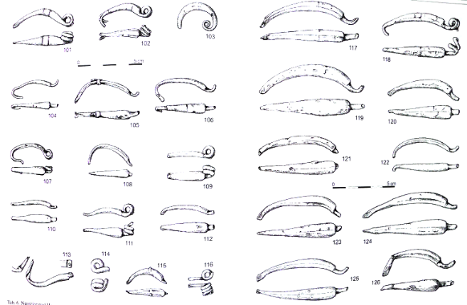
...brooches…

Slide 21
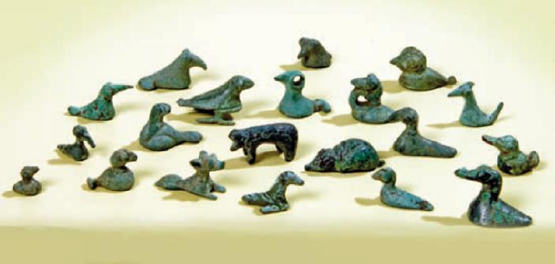
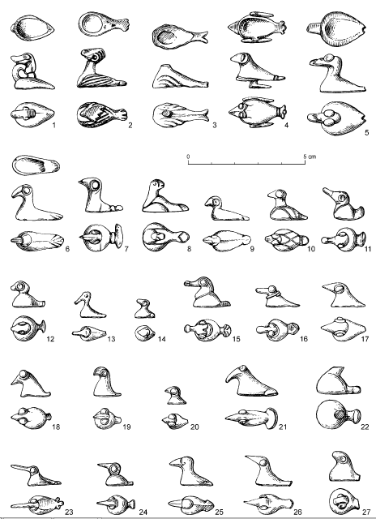
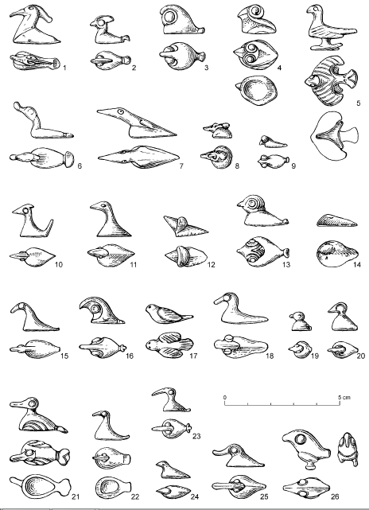
...and animal figurines :~)

Slide 22
- over 500 fragments of glass bracelets which makes Němčice the second richest site in this regard in transalpine Europe
-numerous finds of raw glass and glass production waste all over the settlement

Slide 23
What‘s all this fuss about glass?
-a characteristic innovation of LT C1 is production of ornaments made of colourful glass – bracelets, beads, finger-rings
-glass production is documented in all the LT C agglomerations
Middle Danube agglomerations and glass working
Nowa Cerekwia
Němčice
Roseldorf
https://cas-cz.academia.edu/NatalieVenclov%C3%A1

Slide 24
Seamless glass bracelets are characteristically LT ornament with no formal or technological parallels in the Mediterranean or elsewhere.

Slide 25
Their production required mastering complex set of specialised skills which are not useful for anything more reasonable…
https://cas-cz.academia.edu/Jo%C3%ABlleRolland

Slide 26
Their production required mastering complex set of specialised skills which are not useful for anything more reasonable…
…. So much so that modern glass-workers have not been able to replicate some the bracelet types even after ten years of attempts.
=> LT C society allowed for such an extreme degree of specialisation of individuals who produced objects of symbolic value at the best => there was sufficient subsistence surplus and sufficient demand for the (useless) products
https://www.academia.edu/36697378/Rolland_J._2017_-_Tracing_the_skills_and_identifying_masterpieces_in_Celtic_glass-making_specialization_through_Haevernick_group_15_in_J._Kysela_A._Danielisov%C3%A1_J._Militk%C3%BD_eds._Stories_that_made_the_Iron_Age._Studies_in_the_Iron_Age_Archaeology_dedicated_to_Natalie_Venclov%C3%A1_p.101-_109

Slide 27
Moreover, all the raw material must have been imported from the Mediterranean since the chemical composition of the glass proofs that it all came from Egypt.
+ three shipwrecks in southern France and Sardinia demonstrate that hundreds of kilos of raw glass were imported to Gaul (we have no idea how it got to central Europe).
=> Apart from craft specialisation there must have been enormous trade going on, of which there are no other traces.

Slide 28
Lequin 2
Sanguinaires A
III/II aC – 1 ton of glass
Su Pallosu
III/ – 20 kg (?) of glass

Slide 29
The earliest types of glass ornaments concentrated in the Middle Danube region between Moravia, Eastern Austria, Western Slovakia and Northern Hungary
Only in a second phase glass-working spread also to Bavaria, Bohemia and Western Austria
da Venclová 2016

Slide 30
Introduction of coinage in central Europe

Slide 31
-all coinages of temperate Europe were imitations of different Mediterranean coinages
-as a rule, several coinages of the same region followed the same model (cf. the map)
-silver coinages were represented in a strip from the Carpathian basin through Northern Italy to southern France while gold or bimetallic coinages prevailed in the area going from Slovakia to the Atlantic coast

Slide 32
In Central Europe, two (or three) coinages coexisted in the pre-oppida period:
-the „Boii coinage“ in Moravia, NE Austria, Bohemia and Silesia (Au + Ag)
-the „Vindelician coinage“ in Bavaria (Au + Ag)
(+ Carpathian basin is a different gallaxy: large, exclusively silver coins)
Btw: nobody believes nowadays that the coinages have anything to do with Boii or Videlici – they are just residues or research history…and handy labels

Slide 33
The first coins in Central Europe were staters type Athena-Nike, imitating the coins of Alexander the Great => post-336/323 BC (1st half of the III BC???)
-Only staters = heavy (8,5 gr) gold coins
=> Surely not intended for everyday transactions but rather for large payments, for hoarding and for prestige ends
-Identical motif (Athene/Nike) but a huge variety of execution
-widespread in the entire central Europe
=> presumably issued by numerous authorities (individuals?) in the entire area
from Militký 2018

Slide 34
At the latest in early LT C1, two monetary systems clearly emerged, replacing the Athena/Nike staters:
the Athena Alkidemos coinage in Moravia, Austria and Silesia
the Bohemian local issues in Bohemia
(Bavaria followed later on)
Athena Alkidemos ← the principal motif was taken over from Macedonian issues of Antigonos Gonatas (post 277 BC) depicting the statue of Athena (not sure that whoever carved the dies understood that the figure was supposed to be a female….)

Slide 35
stater
1/3 stater
1/8 stater
1/24 stater
drachma
obolos
Athena Alkidemos coinage was a complex monetary system consisiting of six or seven denominations in two metals

Slide 36
stater
1/3 stater
1/8 stater
1/24 stater
drachma
obolos
The seemingly weird denominations are in reality a mathematically perfect system allowing any sum to be payed with the smallest amount of coins.

Slide 37
-the coins were from the very first moment massively present in all settlements in the area
-(tens of) thousands of coins were issued slightly losing weight over time => the coins circulate and function entirely as economic tools
There is a lot to say about AA coinage. For whoever is interested, the paper below is very good:
https://studiahercynia.ff.cuni.cz/wp-content/uploads/sites/79/2018/07/Tomas_Smely_40-80.pdf

Slide 38
stater
1/3 stater
1/8 stater
1/24 stater
drachma
obolos
The AA coinage was a unitary system, devised as such and consciously imposed upon society which previously had no idea what a coin is… and managed to fully monetise its economy over the course of a single generation.
The system was shared by the entire Amber road area and developed along the same pace in the entire area over several decades.

Slide 39
By contrast, Bohemia in the same period was a total mess: the same system, the same denominations but dozens of coin types are documented, rarely the entire denomination series.
=> Numerous petty authorities and marginal significance in comparison with Moravia and Austria

Slide 40
Glass production regions and early coinages overlap representing clear foci of social and cultural development in LT C1.
https://www.academia.edu/10892786/Natalie_Venclov%C3%A1_-_Ji%C5%99%C3%AD_Militk%C3%BD_2014_Glass-making_coinage_and_local_identities_in_the_Middle_Danube_region_in_the_third_and_second_centuries_B.C

Slide 41
IV–III/II century imports in central Europe are few and – having probably arrived by complicated and individual itineraries – do not say much by themselves…
(btw. the imports from Roseldorf are a grape pip and dill seed).
Stebno
Přítluky
Waldalgesheim
Manching
Roseldorf
Breisach Hochstetten
Szob
Hurbanovo
München
Obermenzing
Teurnia
Mannersdorf

Slide 42
The art …
…and finally drops to deplorable abysses in LT D – representations without any notion of style…
…transitions from the enigmatic and polysemantic elitist creations of LT B – C1 ….
…to clear representations, still respecting the principles of previous arts (LT C2)…
democratication od consumption?
~ coins and glass

Slide 44
THE OPPIDA PERIOD
mid-II–I century BC

Slide 45
Roman occupation of Po valley
190 BC
181 BC
RELEVANT
CONJECTURES
IRELEVANT
CONJECTURES
foundation of Aquileia
resettlement of the Boii from Italy to Bohemia (we have discussed it sufficiently)
FACTS
establishing contacts between Rome and the eastern Alps and NE Balkans
establishment of political links between Rome and Haedui in Gaul
Roman conquest of southern Gaul
122-118 BC

Slide 46
190‘s Roman occupation of the (Celtic) Po valley
180‘s foundation of Aquileia
-Roman informal control of southern France (until its annexation in 120s)
Haedui
Magdalensberg
Arverni
Nauportus
Ocra Pass
Aquileia

Slide 47
Roman occupation of Po valley
190 BC
181 BC
RELEVANT
CONJECTURES
IRELEVANT
CONJECTURES
foundation of Aquileia
resettlement of the Boii from Italy to Bohemia (we have discussed it sufficiently)
Any details of whence, where, when, and why whoever was moving.
FACTS
establishing contacts between Rome and the eastern Alps and NE Balkans
establishment of political links between Rome and Haedui in Gaul
Roman conquest of southern Gaul
122-118 BC
113-102 BC
before 58 BC
before 58 BC
58–50 BC
49 BC
40‘s BC
35 BC
15 BC
the Cimbri and Teutons campaign
Boii attack at Noreia
Suebi (Ariovist) invasion of E Gaul
Gallic war
Norican king with Caesar against Pompey
Boii decimated by the Dacians
conquest of Illyricum and Pannonia by Octavian
Roman conquest of the Alps

Slide 48
the Cimbri and Teutones
Germanic (?) peoples from Danemark / N Germany/?
defeated by the Boii in the „Hercynian forest“ and driven to the Balkans
113 BC defeating the Romans at Noreia
towards the Helveti and to Gaul
109, 107, 105 BC – defeating Romans in Gaul
campaign to Spain and Italy
102, 102 BC – finally defeated by Gaius Marius in battles of Aquae Sextiae and Vercelli
Boii?
Boii?
Boii?
Noreia 113 BC
Scordisci

Slide 49
Roman occupation of Po valley
190 BC
181 BC
RELEVANT
CONJECTURES
IRELEVANT
CONJECTURES
foundation of Aquileia
resettlement of the Boii from Italy to Bohemia (we have discussed it sufficiently)
Any details of whence, where, when, and why whoever was moving.
FACTS
establishing contacts between Rome and the eastern Alps and NE Balkans
establishment of political links between Rome and Haedui in Gaul
Roman conquest of southern Gaul
122-118 BC
113-102 BC
before 58 BC
before 58 BC
58–50 BC
49 BC
40‘s BC
35 BC
15 BC
the Cimbri and Teutons campaign
Boii attack at Noreia
Suebi (Ariovist) invasion of E Gaul
Gallic war
Norican king with Caesar against Pompey
Boii decimated by the Dacians
conquest of Illyricum and Pannonia by Octavian
Roman conquest of the Alps

Slide 50
the Cimbri and Teutones
Germanic (?) peoples from Danemark / N Germany/?
defeated by the Boii in the „Hercynian forest“ and driven to the Balkans
113 BC defeating the Romans at Noreia
towards the Helveti and to Gaul
109, 107, 105 BC – defeating Romans in Gaul
campaign to Spain and Italy
102, 102 BC – finally defeated by Gaius Marius in battles of Aquae Sextiae and Vercelli
Boii?
Boii?
Boii?
Noreia 113 BC
Scordisci

Slide 51
Roman occupation of Po valley
190 BC
181 BC
RELEVANT
CONJECTURES
IRELEVANT
CONJECTURES
foundation of Aquileia
resettlement of the Boii from Italy to Bohemia (we have discussed it sufficiently)
Any details of whence, where, when, and why whoever was moving.
FACTS
establishing contacts between Rome and the eastern Alps and NE Balkans
establishment of political links between Rome and Haedui in Gaul
Roman conquest of southern Gaul
122-118 BC
113-102 BC
before 58 BC
before 58 BC
58–50 BC
49 BC
40‘s BC
35 BC
15 BC
the Cimbri and Teutons campaign
Boii attack at Noreia
Suebi (Ariovist) invasion of E Gaul
Gallic war
Norican king with Caesar against Pompey
Boii decimated by the Dacians
conquest of Illyricum and Pannonia by Octavian
Roman conquest of the Alps

Slide 52
We learn about the events of 58 BC (and slightly before) thanks to the first book of Caesar‘s Gallic Wars (but read it aware of his propagandistic interests)
https://www.perseus.tufts.edu/hopper/text?doc=Perseus:text:1999.02.0001
„the Boii who dwell beyond the Rhine, were crossing (the Danube?) to Noricum and who (had?) beseiged Noreia“ joined the Helvetii who tried to migrate to western Gaul in order to avoid the Germans (threatening Roman allies the Haedui).
Germans push the Celts out beyond the Rhine
the German Suebi lead by Ariovistus occupied eastern Gaul
Boii?
Boii?
Boii?
Suebi
Boii?
Sequani
Haedui
Helvetii

Slide 53
-Rome was politically fully involved in Gaul (close relations with Haedui but also with Ariovistus!)
-Caesar needed to :
1) justify his deeds with protection of interests of Rome
- protecting Roman allies (Haedui, Norici)
- preventing problems in the Roman sphere of interest (and why not also enlarging it?)
2) Glorify his exploits by conquering the entire Gaul
-constant mentions of tense relations between Celts and Germans = fearmongering recalling the only Germans the Romans had encountered – the Cimbri. By driving the germanic threat from Gaul he made himself a new Marius.
-by contrasting Gaul with the („Germanic“) territories beyond the Rhine he himself defined the Gaul to conquer and did not need to worry about the rest (it is not at all sure, it is even unlikely that a distinction between Gaul and „Germany“ existed beforehand for the Gauls themselves)
-Boii were represented as threat because they (incidentally) endanger Roman interests in Noricum and Gaul, otherwise Caesar doesn‘t care much about them
=> The Roman sphere of interests involved Gaul and eastern Alps. The Romans were somewhat aware of central Europe but did not care much (yet).

Slide 54
III–I c. BC LT agglomerations in Europe (some of them)
Principally LT C–C2
Principally LT C2–D
Nowa Cerekwia
Němčice n.H.
Bobigny
Manching
Roseldorf
Lacoste

Slide 55
Archaeology of Late La Tène period in Central Europe
-over LT C2, the occupation spread to previously unoccupied territories
-a series of fortified hill-top settlements of entirely new type – oppida – was established (in Bohemia they mostly concentrate in the southern half of the country)
Between LT C2 and LT D2, oppida appeared in most of LT Europe though with a significant variability from region to region in terms of typology, chronology, material culture, etc.
http://oppida.org/

Slide 56
In early 1900s Joseph Déchelette first realised the striking similarity of material culture between several European fortified sites, defining thus a „civilisation des oppida“.
Currently we tend to see more diversity within the LT Europe than Déchelette but still admit that much of the phenomenon is very similar throughout Europe.

Slide 57
Oppida – the problems:
1) definition
-with…
…centrale functions
… concentration of inhabitants, cratfs and trade
… coin production
-hill-top site
-fortified
-of at least 5/10 /25 /30 hectars
-dated to LT C2–D
Blah blah blah blah oppida
Blah bla oppidum blah oppidorum blah blah …..
-the word is taken from Caesar meaning simply „town“
-in archaeological usage it became a very specific technical term whose criteria may vary from region to region (and from archaeologist to archaeologist)
-not all „archaelogical oppida“ correspond with „Caesar‘s oppida“ … many archaeologists do not realize it (Caesar doesn‘t care)

Slide 58
Oppida – the problems:
2) too much focus on them
-mainly in the 20th century all research attention was dedicated to the oppida, while other settlement forms were ignored (including agglomerations, some of which could be called „oppida“ by Caesar)

Slide 59
Oppida – the problems:
3) too diversified to make sense
 |  | LT C1 | LT C2 | LT D1a | LT D1b | LTD2
southern Bavaria | Manching | A | A | O | O | -
 | Kelheim | ? | ? | O | O | -
 | Berching-Pollanten | A | A | A | A | -
 | Egglfing | A | A | a | a | -
 | Straubing | a | A | A | A | A
 | Fentbachschanze | ? | ? | O | O
 | Steinebach | A | A | A | A
Bohemia | Lovosice | A | A | A | A
 | Mšec 1 | a | a
 | Mšecké Žehrovice | ++ | ++ | +
 | Závist | +? | O | O | O
 | Stradonice | +? | +? | O | O
 | Hrazany |  | O | O | O
 | Třísov |  | O | O | O
 | České Lhotice |  | O | O
 |  | LT C1 | LT C2 | LT D1a | LT D1b | LT D2a | LT D2b
Berry | Châteaumeillant |  | A | O | O | O
 | -Levroux les Arénes -Levroux Tour | A | A
 |  |  |  | O | O | O
Auvergne | Varennes sur allier | A | A
 | -Aulnat -Corent -Gergovie -Gondole | A | A
 |  |  |  | O | O | O
 |  |  |  |  |  | O
 |  |  |  |  |  | O
Central-Eastern. France | -Avallon „Damoiseau“ |  | A | A
 | -Avallon/Aballo |  |  |  | O | O
 | -Bibracte -Sources de l‘Yonne |  |  | o | O | O | O
 |  |  |  |  |  | A
 | -Chalon – Lux -Chalon – St. Rémy | a | A | A | a
 |  |  |  |  |  | A
 | -Verdun – Le Bourg -Verdun – Petit Chauvrot |  |  |  | a
 | - Mâcon - Varennes-lès-Mâcon -Saint-Symphorien |  |  | o | O | O
 |  |  |  | A
 |  |  |  | A
 | Besançon | + | a | O | O | O | O
Upper Rhine | -Breisach Hochstetten -Breisach Münsterberg | A | A | A | A
 |  |  |  |  |  | V
 | -Basel Gasfabrik - Basel Münsterhügel | A | A | A | ?
 |  |  |  |  | ? | V
 | - Tarodunum -Zarten-Rotacker |  |  |  | O
 |  |  | A | A
From region to region the relation between oppida, agglomerations and other sites vary and so probably did their function
Thuringia | Gleichberg | + | O | O | O
 | Jüchsen | a? | A? | A? | A?
Moravia | Němčice | A | A
 | Staré Hradisko |  | O | O | O
Middle Danube | Oberleiserberg | V | V | V | V
 | Roseldorf | A | A | a | A
 | Thunau am Kamp | A | a
 |  |  |  | V | V
 | Bratislava |  |  |  | O | O
oppidum
Hill-top site
agglomération
occupation

Slide 60
Most oppida were newly founded in quite peripherical areas (For better defensibility? Access to raw materials?)
Bibracte – Mont Beuvray near Autun in Burgundy

Slide 61
Manching
Manching is atypical in most respects (but Manching is always special…)
-located in a fertile lowland
-an earlier agglomeration only secondarily enclosed by a rampart
-much of the enclosed area was left unoccupied…but the latter is a common feature in all oppida

Slide 62
Stradonice
If there is one oppidum to know in Bohemia, it is Stradonice

Slide 63
Staré Hradisko
In Moravia the choice is much simpler: there is only one real oppidum, Staré Hradisko

Slide 64
-oppida ramparts combined timber and rubble stone in purely transalpine tradition with no Mediterranean analogies or antecedants
(Btw. also from the urbanistic point of view, there is no link between the oppida and Mediterranean towns)

Slide 65
The coinages of the pre-oppida period…

Slide 66
…disappeared and were reaplced by a new coin type, the „shell stater“ massively issued in southern part of Bohemia (that‘s where all the oppida emerged in this period)

Slide 67
The denomination system was still that of the Athena Alkidemos only with new abstract motifs.

Slide 68
LT C = 8
LT D1 = 7 gr
LT D2 =6,5 gr
99–95 % Au
Although the coins progressively lost weight (which is a sign of functioning economy), the purity of gold was kept very high all the time (unlike e.g. Bavarian coinage in which the gold is much less pure).
=> Apart from actual coins, the „shell staters coinage“ may have been also commodity i.e. minted gold meant for export.

Slide 69
This hypothesis is supported by numerous finds of large hoards of Bohemian coins discovered in a vast area from Alsace to Serbia with one even in Tuscany.

Slide 70
MEDITERRANEAN AND THE TRANSALPINE EUROPE IN THE OPPIDA PERIOD
Gaul
Central Europe
Gaul (direct contact with Roman Province) × Central Europe
https://www.academia.edu/70395841/Things_and_Thoughts_Central_Europe_and_the_Mediterranean_in_the_4th_1st_centuries_BC
https://www.academia.edu/39772548/the_Celts_2018_2019_-_Bohemia_and_Mediterranean p. 287–292

Slide 71
-Gaul was flooded with millions of amphorae
-There is a significant correspondence between specific export and consumption => firmly established trade relations and stable trade going on for many decades
-Among the principal consumption/redistribution areas there is the territory of Haedui – the principal allies of Rome
F. Olmer
https://otmed.academia.edu/OLMERFabienne

Slide 72
The economic connection of Gaul is the introduction of quinarius coins aligned with Roman coinage and creating thus a „monetary union“ between Rome and Central-Eastern Gaul (= Haedui) in the I century BC

Slide 73
It‘s all very different in Central Europe in which btw three areas are worth comparig: Bohemia, „Western Central Europe“ and „Eastern Central Europe“

Slide 74
The principal evidence of imported objects are fragments of bronze vessels
…. Lots of fragments of bronze vessels
Three out of many sheets just from the oppidum of Stradonice

Slide 75
Between genuine luxury and geniune trash

Slide 76
Bohemia is characterised by very numerous finds of imported finger rings with intaglios….

Slide 77
… but in actual fact, the „intaglios“ are in their majority glass paste junk in which the motifs are rarely visible and the copper alloy rings are made of brass (which looks like gold and which was not known in central Europe in the period)
=> Did the Romans sell them junk made of fake gold with crappy fake intaglios?
Yes, why not…?
Cat. n° | N° measurements | Fe | Cu | Zn | Sn
S1 | 3 | 0,70 | 84,77 | 4,45 | x
S2 | 2-side | 1,75 | 58,55 | 22,95 | x
S2 | 3-bezel | 1,53 | 59,66 | 6,52 | x
S8 | 7-bezel | 0,19 | 70,22 | 9,80 | x
S8 | 5-side | 0,30 | 82,50 | 3,19 | x
S9 | 2-surf. | 1,49 | 61,15 | 7,71 | x
S9 | 3- frgm | 1,50 | 75,48 | 11,89 | x
S10 | 4 | 1,33 | 63,72 | 8,42 | 1,34
S11 | 2 | 0,87 | 75,64 | 9,63 | 0,34
S12 | 2 | 0,34 | 77,63 | 4,90 | x
S13 | 2 | 0,55 | 84,37 | 8,14 | 0,36
S14 | 3 | 0,78 | 83,67 | 5,76 | 0,06
S15 | 2-side | 0,13 | 92,16 | 3,49 | x
S15 | 1-bezel | 0,39 | 82,26 | 4,11 | x
S16 | 2 | 0,36 | 85,42 | 9,05 | x
S26 | 3-surface | 1,09 | 81,38 | 7,10 | 0,52
S27 | 2-side | 0,52 | 85,38 | 3,36 | x

Slide 81
Central Europe was apparently in contact with Italy via Gaul and Bavaria or via Eastern Alps and the Middle Danube region
Bohemia stood in between the two circuits as a passive black hole dependent on the two other regions

Slide 82
-all regions share the same categories represented by the same object types in roughly the same proportions
Regular trade concerning all the regions

Slide 83
The absolute majority of finds come from oppida (dark grey)
-most imports concentrate in always one site per region (Stradonice in Bohemia, Manching in Bavaria, Staré Hradisko in Moravia/lower Austria)
-the same sites have also the most varied and „complete“spectrum of import categories
-while Bohemia is the region with most finds, the objects are represented in the smallest number of sites, 95% of them are oppida. In the other two regions the sites are both more numerous and more varied.

Slide 84
Bohemia exported huge bulks of high quality gold coinage…
Bohemia imported some bronze vessels, but also many mirrors, glass beads, and rings made of fake gold…not very flattering analogies come to one‘s mind….
Unlike Bohemia, Bavaria and Moravia/Lower Austria are better furnished with really luxurious objects (glass vesels) and with e.g. pottery which demonstates better understanding for Mediterranean ways of live.
Wider distribution of imports in Bavaria and Moravia/Lower Austria suggests their greater exclusivity in Bohemia where they were accessible only to a few selected central sites.
All imports necessarily came to Bohemia through Bavaria or Moravia rather than directly from Italy.

Slide 85
Around the middle of the I century BC, the LT culture in central Europe came to its end.
Manching in its latest phases (LT D1b = 2/4 of I BC) showed decline in all the signs of its previous social, economic, and architectural complexity.
Most oppida were abandoned (only Stradonice may have survived to the ¾ of I BC but only as a shade of what it was) and LT culture disappeared…
?
Blava
…while at the other end of Central Europe, a new oppidum and the only real centre of the period surged rapidly and suddenly: Bratislava.

Slide 86
The existence of Bratislava oppidum had been known for a long time, most famously thanks to several large hoards of coins combining local version of the „shell staters“ with purely local „Biatec“ tetradrachmas – large silver coins imitating Roman denarii and bearing inscriptions (names?) in Latin characters (e.g. Biatec, Nonnos Bussumarus, Ainorix etc.)
Bratislava

Slide 87
… but then large rescue excavations in the Bratislava castle in 2009–2014 revealed something unexpected….

Slide 88
Wherever LT period levels were preserved, there were remains of structures built in Roman construction techniques:
-walls of opus incertum (cement-bound rubble stones)
-floor in opus signinum (cement-based conglomerate with ground and polished surface)
-wall paintings (only minuscule fragments are preserved)
-though strangely, there is not a single fragment of rooftiles (I have an explanation… what do you think about it?)

Slide 89
Walls in opus incertum
Floors in opus signinum – the decoration correspond to floors documented in contemporary Northern Italy
Excavated
Reconstructed

Slide 90
The building on the Castle court is a large 23×9 m structure with twice as thick (= twice as high) walls as the other buildings and based on the preserved floor fragments probably without any inner partition walls => a building extremely similar to Roman basilicas.

Slide 91
Incidentally, a building of basically identical form and dimensions built in the same period of ca. 50 BC was discovered in Bibracte (i.e. the capital of Haedui repeatedly frequented by Caesar and his troops in exactly this period).
23 × 9 m
Btw. the fact that they resemble basilicas does not mean that they also had the same functions.
https://www.academia.edu/1347269/Un_exce_s_de_la_romanisation_L_identification_dans_les_villes_gauloises_de_monuments_civiques_romains
24 × 14 m

Slide 92
+ there are hundreds of fragments of amphorae (mostly from the Adriatic but also from Greece)

Slide 93
Other imports on the other hand are not that breath-taking… they are there but they do not exceed the norm of an oppidum

Slide 94
In comparison with the rather similar other large oppida, in Bratislava there are much more numerous amphorae and pottery, other categories are represented in insignificantly low numbers
=> Bratislava is more similar to oppida in Gaul than to those in Central Europe

Slide 95
Worth comparison with Bratislava is another site recently discovered in Vienna: Wien-Rochusmarkt.
-here a few LT D1b–2 settlement pits produced impressive series of imported pottery and other artefacts.

Slide 96
(pseudo)amber
Roman tableware
Roman cooking pottery
Writing instruments
Local pot with a Latin inscription

Slide 97
=> Stradonice/Manching/SH, Vienna, and Bratislava are three very differentstories:
-numerous luxurious or exotic goods in a purely LT milieu
-no significant signs of adoption of Mediterranean way of life: bronze vessels could be used for consumption of beer or mead, writing was common in Gaul in local languages, no other artefacts suggesting more than that Mediterranean was fashionable
-massive import of bulky amphorae, relatively more (but still very few) pottery, some local imtation of Roman tabelware but also of cooking vessels
=> More direct access to trade, deeper aquaintance with Mediterranean way of life and someattempts to imitate it but essentially still LT milieu
-very few amphorae (goods) but numerous Roman cooking vessels, lot of writing and writing in Latin => living the Roman way
=> Roman traders?

Slide 98
What is Bratislava???
-extremely powerful elite issuing a new coinage (modelled on Roman coins and using Latin script)
-unprecedented contact with Italy evidenced by massive import of wine and mainly by the large and extermely numerous buildings which must have been carried out by Italian architects

Slide 99
The only thing we know directly about the area from written sources is that Dacians decimated the Pannonian Celts sometime between 40s and mid 30s BC
The end of Bratislava was often associated with this event… no more.
Boii?
Taurisci
Scordisci
Strabo VII, 3, 11; VII, 3, 2; VII, 5, 6

Slide 100
Hercynia sylva
Hercynia sylva
Boiohaemum
Hercynia sylva
The next thing we learn is that in 6 AD Tiberius prepared to marched against Marobudus „from Carnuntum“ (ca. midway between Bratislava and Vienna) (Velleius Paterculus II,108–109)
Some colleagues suggested that this Carnuntum was actually Bratislava… for no good reason.

Slide 101
The Bratislava amphorae date to ca. 50s–30s BC, some other imports suggest that the site could have been occupied at the latest in early 20s BC…
=> Bratislava possibly survived the Dacians but was abandoned long time before Tiberius crossed the Alps
Tiberius‘ campaign
against Marobudus
Amphorae
Some other stuff
100
90
80
70
60
50
40
30
20
10
0
10
20
Dressel 1
Dressel 2-4
Lamboglia 2
Lamb. 2/Dr. 6A
Dressel 6A
Brindisine
Middle Adriatic ovoid. amph.
Dangstetten 15-8/7 a.C.
Pula 43 a.C.

Slide 102
What we know indirectly about Central Europe of the period
59 BC – Caesar received Galia Cisalpina and Illyricum as his proconsular provinces, Galia transalpina was added later after its governor died
58 BC – all Caesar‘s legions stood at Aquileia ready to conquer someting though perhaps not Gaul where they ended up later that year
49 BC – the Norican king sent troops to help Caesar => personal alliance maintained by Caesar?
44 BC – Caesar planed a campaign against the Dacians (= conquest of Carpathian basin)
35 BC – first thing Octavian did after gaining control over Italy was conquest of Carpathian basin
supreme interest of Caesar, (Marc Antony, Assinius Polio,) and Octavian for the region and surely need for local allies
Bratislava may be the result of forging alliance in a strategic place of Carpathian basin, attaching them to Rome with prestige gifts.
… the project failed for an unknown reason (Dacians?) and when Roman re-appeared in the region around BC/AD, there was nothing left after Bratislava or the LT culture

